Slide 1


Techniques for adapting industrial heritage through design
—— (on example of Changzhou Canal № 5)
通过设计活化工业遗产研究技术
— —以常州第五毛纺织厂为例
Name: Wang tancai English Name: Matthew Full Name of Supervisor: Olena Sharlai Student ID: S24101357058

Slide 2
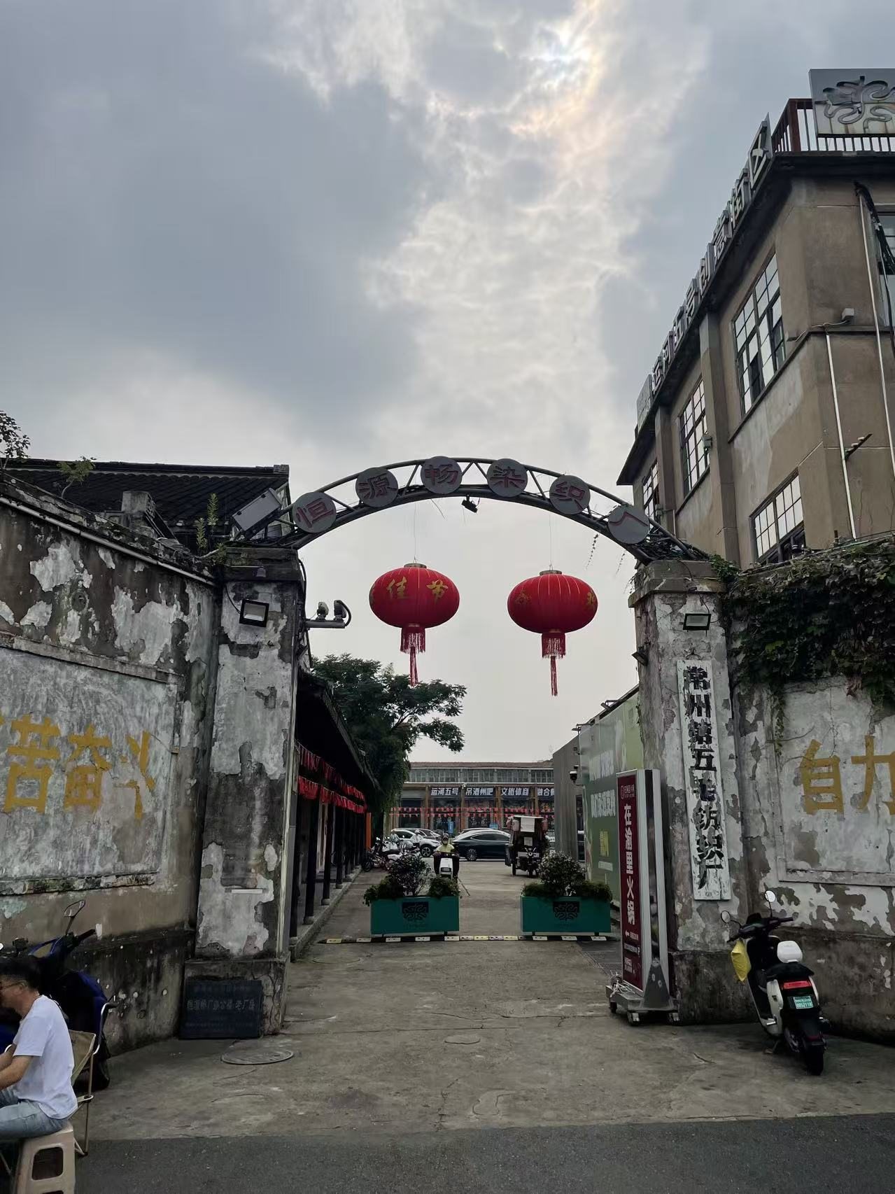
01
Research Background and Significance
Urban Renewal · Industrial Heritage · Digital Media
From "Space Reuse" to "Experience Reproduction"
Notes:
1.7.2013
This is the first chapter of our presentation, focusing on the background and significance of the research.
We will explore the intersections of urban renewal, industrial heritage preservation, and digital media technology.
‹#›

Slide 3
1.1 Research Background
①
②
③
Urban Renewal Shifts to Stock Optimization
Industrial Heritage Needs Cultural Interpretation
Digital Media Provides a New Interface
Urban renewal is shifting from outward expansion to optimization of existing urban space. Old factory areas are no longer merely targets for demolition, but are redefined as public cultural resources carrying city memory and local identity, requiring careful preservation and creative transformation.
The tangible remains—architecture, equipment, production processes—and intangible workers' memories are often scattered and fragmented. They need to be organized into an understandable and engaging narrative system through professional design to resonate with the public.
Digital imaging, AR/VR, interactive projection, sound maps, and smart guides can bring dormant historical information back to the original site, creating immersive, interactive experiences that bridge the gap between the past and present visitors.
The renewal of industrial heritage is evolving from "space reuse" to "experience reproduction"
Notes:
1.7.2013
Before we delve into the specifics, let's understand the research background that underpins our project.
First, urban renewal is undergoing a significant shift. We are moving away from the era of large-scale demolition and outward expansion towards a focus on stock optimization. Old industrial areas are no longer just eyesores to be cleared away; they are recognized as vital public resources that hold the memory and identity of the city.
Second, industrial heritage is rich but often fragmented. The physical structures, old equipment, and the stories of the workers are scattered. Without proper cultural interpretation and organization, these elements remain silent and fail to connect with the public.
Finally, digital media offers a powerful new interface. Technologies like AR, VR, and interactive projections allow us to overlay historical information onto the physical site, creating immersive experiences that bring the past to life in a way that static displays cannot.
In essence, we are witnessing a transition from simply reusing space to reproducing experiences that engage people on a deeper level.
‹#›

Slide 4
1.2 Research Significance
On the basis of protecting the authenticity of existing factories, equipment, and historical environments:
Heritage Body
Establish a systematic media framework that interweaves heritage preservation, historical narrative, spatial perception, and public engagement into a cohesive whole.
Public Participation
Historical Info
Digital
Media
Bridge the disciplinary gap between traditional industrial heritage conservation and modern digital media spatial design, fostering interdisciplinary innovation.
Transform static industrial relics into dynamic, interactive public cultural spaces, revitalizing their social and cultural value in the contemporary context.
Spatial Experience
Digital media should serve as an integrative layer — not decorative technology
Notes:
1.7.2013
This slide outlines the core significance of our research. We aim to explore how digital media can be more than just a tool; it's a layer that integrates heritage, history, space, and public interaction.
By focusing on these four pillars, we seek to bridge the gap between conservation and innovation, turning static relics into living, breathing cultural spaces.
‹#›

Slide 5
1.3 Research Object & Purpose
Research Object
Focus: Changzhou No.5 Wool Textile Factory & Canal No.5 Creative District (Jiangsu, China)
01 Physical Heritage
02 Spatial Environment
03 Info & Experience
Preserved old factory buildings, iconic saw-toothed roofs, red brick walls, industrial chimneys, and original textile machinery as core physical carriers.
Interwoven streets, alleys, inner courtyards, the factory entrance, and the unique waterfront landscape along the ancient canal.
Intangible textile industry history, collective memories of workers, digital navigation systems, immersive exhibitions, and interactive visitor engagement.
Research Purpose
To explore the synergistic relationship between urban renewal, industrial heritage conservation, and digital media design. This study examines how digital technologies can innovatively support spatial regeneration, enhance cultural expression, and maintain the authentic historical features of industrial heritage sites for sustainable development.
→ Fragmentation of Info
Disconnected historical narratives and scattered archival data hinder the formation of a coherent heritage context.
→ Static Exhibition Gap
Traditional static displays create a disconnect between visitors and dynamic historical space, lacking depth.
→ Youth Engagement Deficit
Insufficient interactive elements fail to attract younger generations to engage with industrial heritage.
Notes:
1.7.2013
This slide outlines the research object and purpose.
The research focuses on Changzhou No.5 Wool Textile Factory and Canal No.5 Creative District. We analyze three key aspects: the physical heritage (the buildings and machinery), the spatial environment (the layout and waterfront), and the information and experience (history, memories, and interaction).
The purpose is to explore how digital media can bridge the gap between heritage conservation and urban renewal. Specifically, we aim to address three main issues: fragmented historical information, the limitations of static exhibitions, and the lack of engagement from younger audiences.
‹#›

Slide 6
1.4 Research Objectives & Methods
Five Research Objectives
Research Methods
1
Construct a robust theoretical basis for digital media interventions in industrial heritage renewal, integrating heritage conservation theories with media technology.
01 Theoretical Level
• Literature review: Systematic analysis of heritage studies and media theories.
• Case study: Comparative analysis of global digital heritage practices.
• Logical synthesis: Inductive reasoning to form theoretical constructs.
2
Identify and define the core heritage values (cultural, historical, aesthetic) and diagnose the existing spatial, functional, and operational challenges of the research site.
3
Analyze the interactive relationship between digital media applications and industrial heritage spaces through cross-cultural case studies and comparative analysis.
4
Develop a systematic design framework for digital-media-empowered reconstruction, outlining key principles, implementation strategies, and evaluation metrics.
02 Practical Level
• Empirical research: On-site investigation and spatial mapping.
• User-centric: Behavioral observation and stakeholder interviews.
• Design practice: Visual documentation and prototype implementation.
5
Validate the framework’s validity and feasibility through a practical design intervention project at Changzhou No.5 Wool Textile Factory.
Notes:
1.7.2013
This slide outlines the core research objectives and methodologies.
On the left, we have five key objectives starting from building a theoretical foundation to validating the framework through a real-world case study.
On the right, we divide the research methods into two levels: theoretical and practical, ensuring a comprehensive and grounded approach to the study.
‹#›

Slide 7
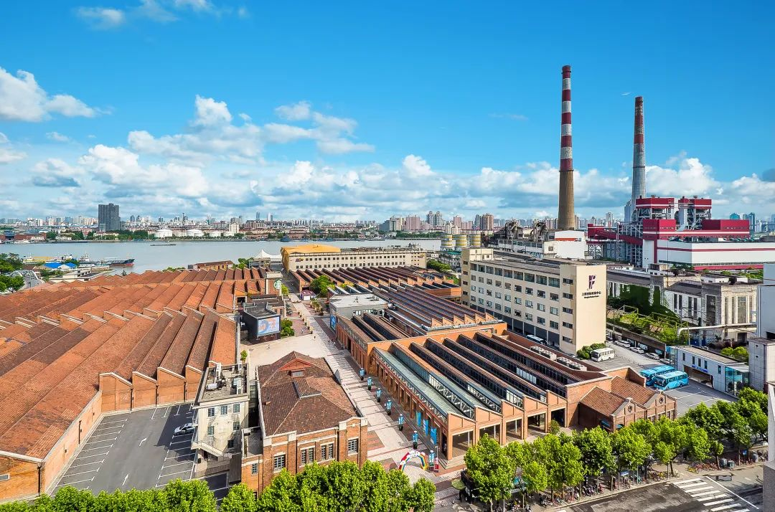
Object of research
Renovation of industrial relics left over from the city
Starting from the new paths provided by digital media, with features such as "immersive experience", "dynamic interaction", and "data-driven", it can solve the problem of industrial heritage revitalization and achieve "dynamic reconstruction".
常州第五毛纺织厂作为运河五号创意街区的文化核心，存在展陈静态化、文化传播断层、与街区和社区联动薄弱等问题，客流与消费转化不足，急需进行数字化改造以改善现状。
城市遗留工业遗迹的翻新
从数字媒体提供的新途径出发，借助“沉浸式体验”、“动态互动”和“数据驱动”等特点，可以解决工业遗产的振兴问题，实现“动态重建”。

Slide 8
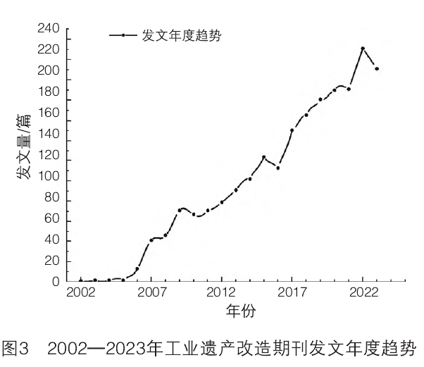
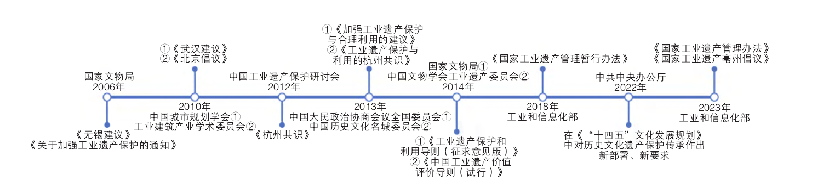
Chronological boundaries of the research
Focusing on the construction practices of industrial heritage in China in recent years, the latest research findings on industrial heritage are based on the policies issued by the government at present.
国内早期工业遗存重构聚焦“物理空间改造”，如北京798、上海M50的功能置换。近年引入数字技术，但多针对重工业，纺织类遗存数字化仅停留在“设备外观展示”，未还原全流程。

Slide 9
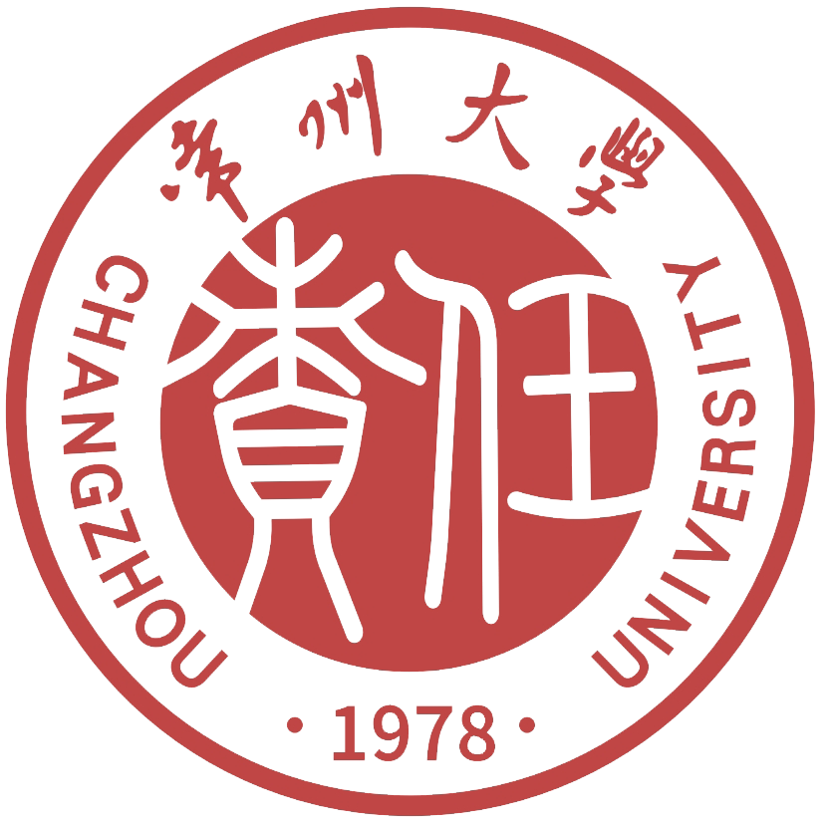
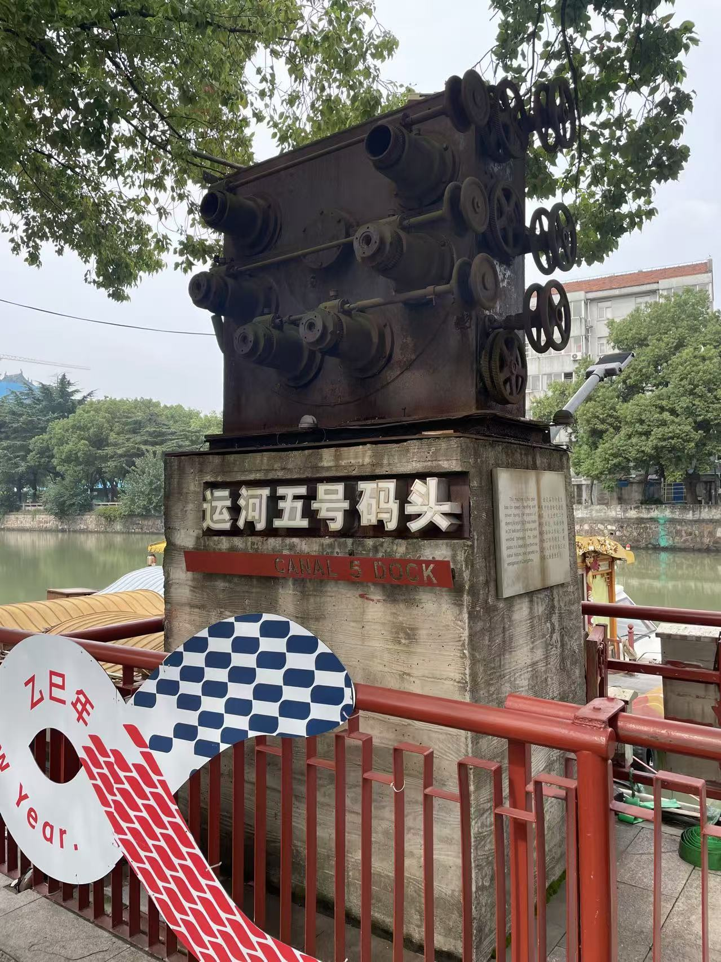
02
Example from practice

Slide 10
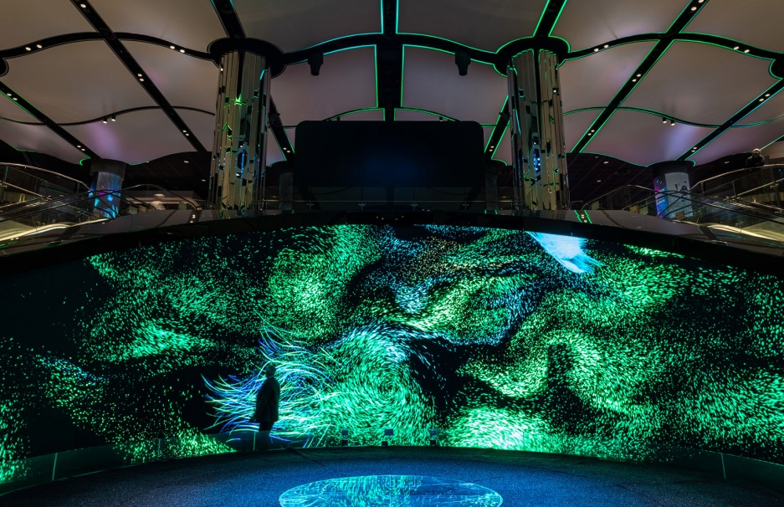
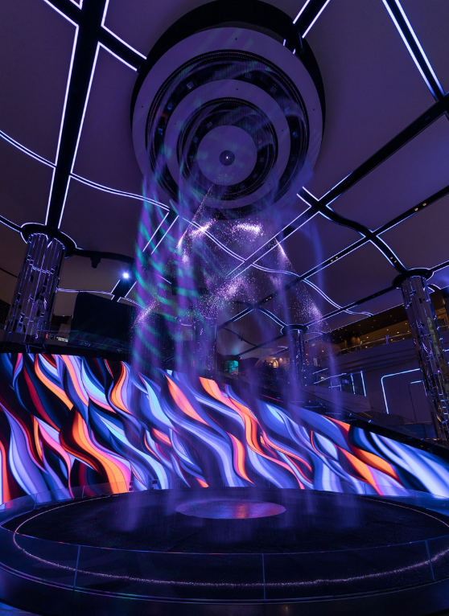
Case Study
The Star Immersive Experience Space
This innovative platform transports art out of the gallery context and into the public realm. As meditative as it is spectacular, visitors are welcomed into an immersive moment that surrounds and envelops,

Slide 11
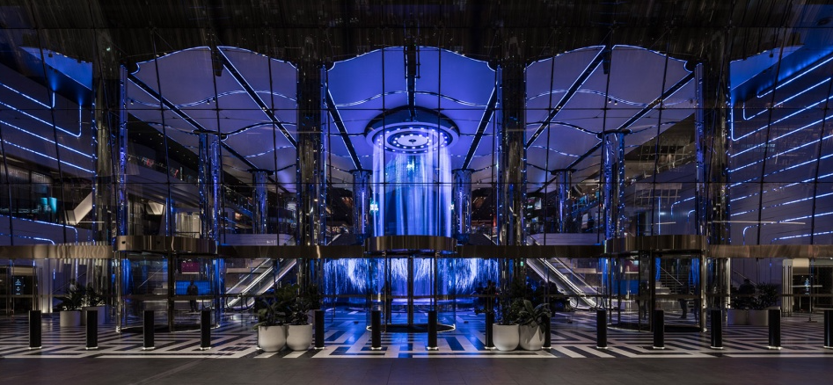
Case Study
The Star Immersive Experience Space
The immersive experience stems from a 25m, 8k resolution, interactive digital canvas at the centre. Curated to the human rhythm, the canvas expresses Sydney’s light and movement through the digital artworks of local and international artists, animators and cinematographers.

Slide 12
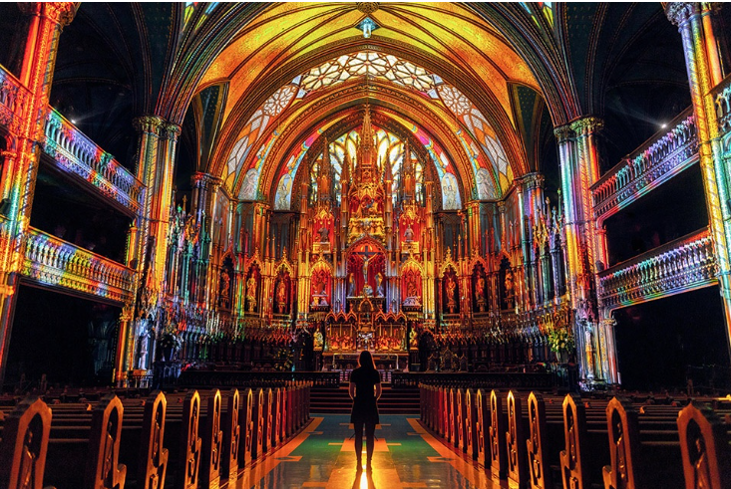
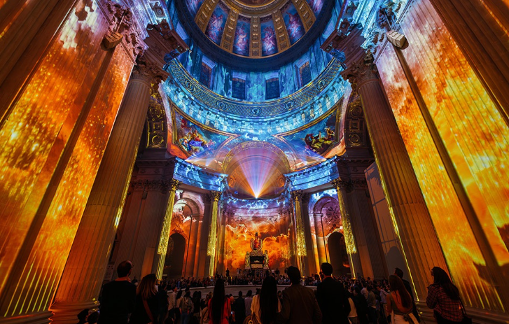
Case Study
Montreal
These immersive experiences breathe new life into heritage sites after dark, transforming their indoor spaces by illuminating centuries of tradition, artistry, and craftsmanship in new and unexpected ways.

Slide 13
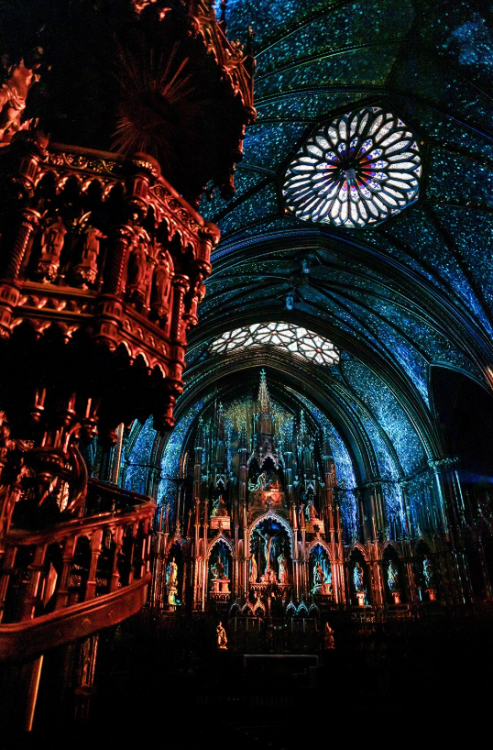
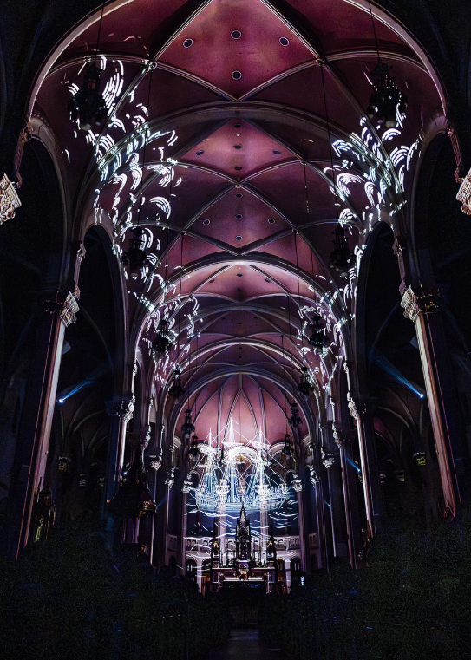
Fusion of historic ornament and digital imagery

Slide 14
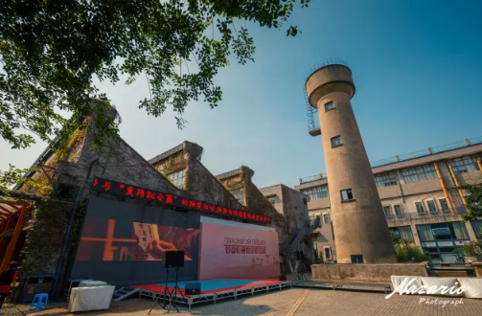
03
View the project

Slide 15
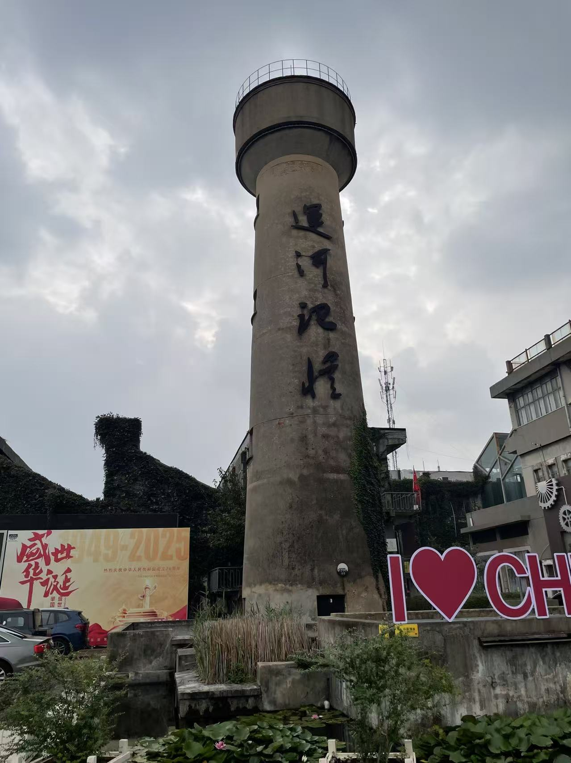
Problems in the surrounding area
01
Degradation of building performance
02
Lack of barrier-free facilities
03
Mixed traffic in the neighborhood
04
Spatial chaos and scarcity
05
The safety management is worrying
06
Loss of community culture

Slide 16
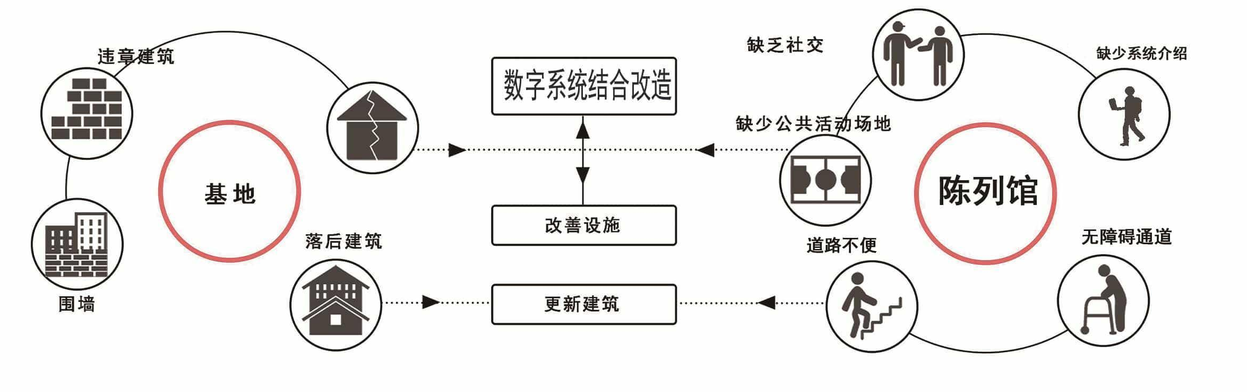


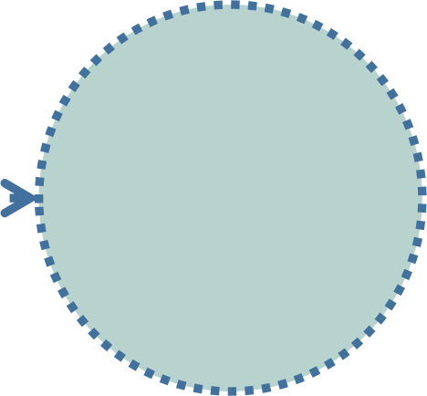
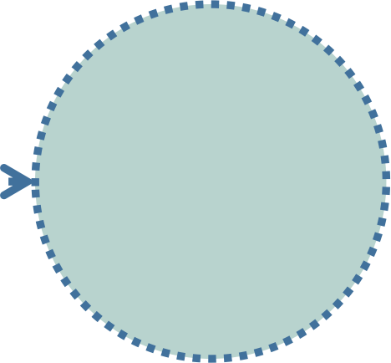
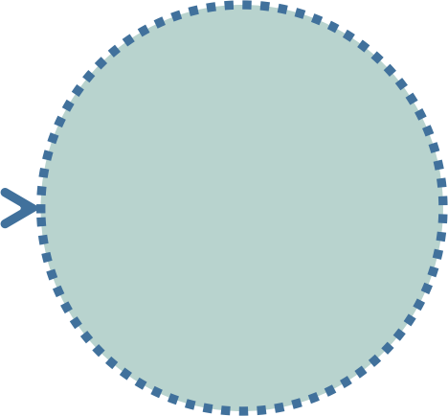

transformation strategy
Strengthen
overall
planning and
construction
Route planning and layout
Introduce
advanced
intelligent
systems
Improve the service system
Integrate
local
characteristics

Slide 17
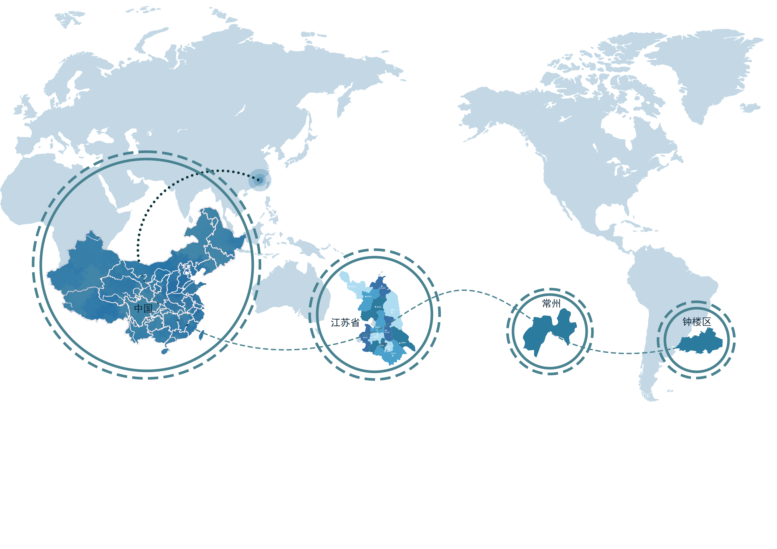
Location Analysis
Canal No.5 Creative District is located on Sanbao Street in Changzhou City, on the south bank of the Beijing-Hangzhou Grand Canal. It serves as a crucial node in Changzhou's implementation of the "Central Area Improvement" strategy and the construction of the "Canal Historical and Cultural Industrial Belt".

Slide 18
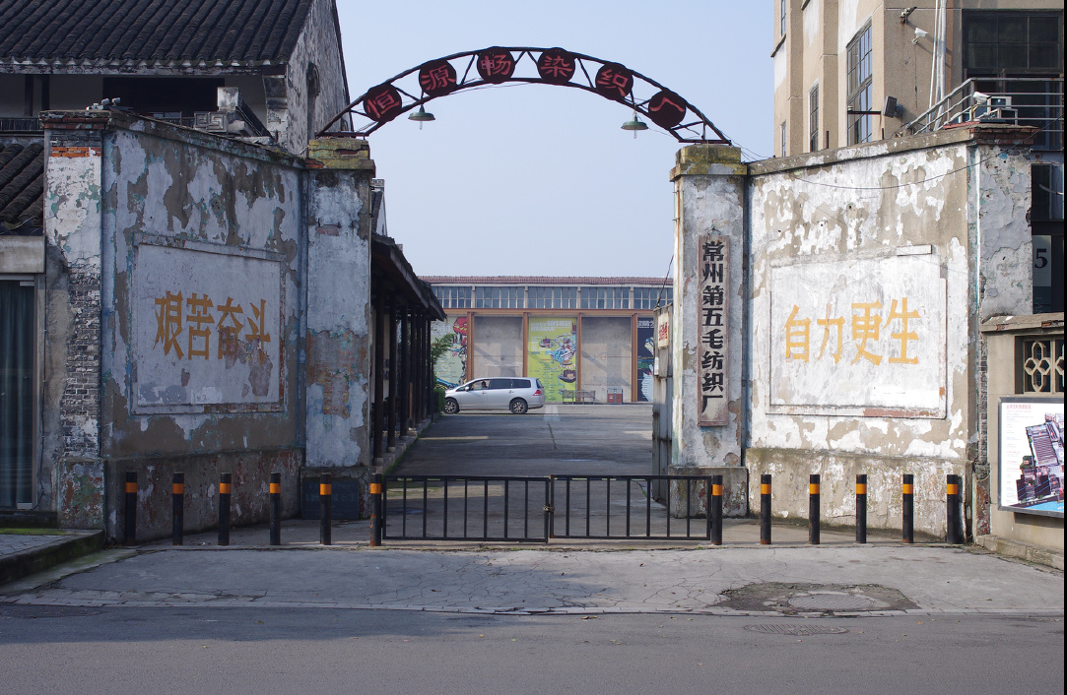
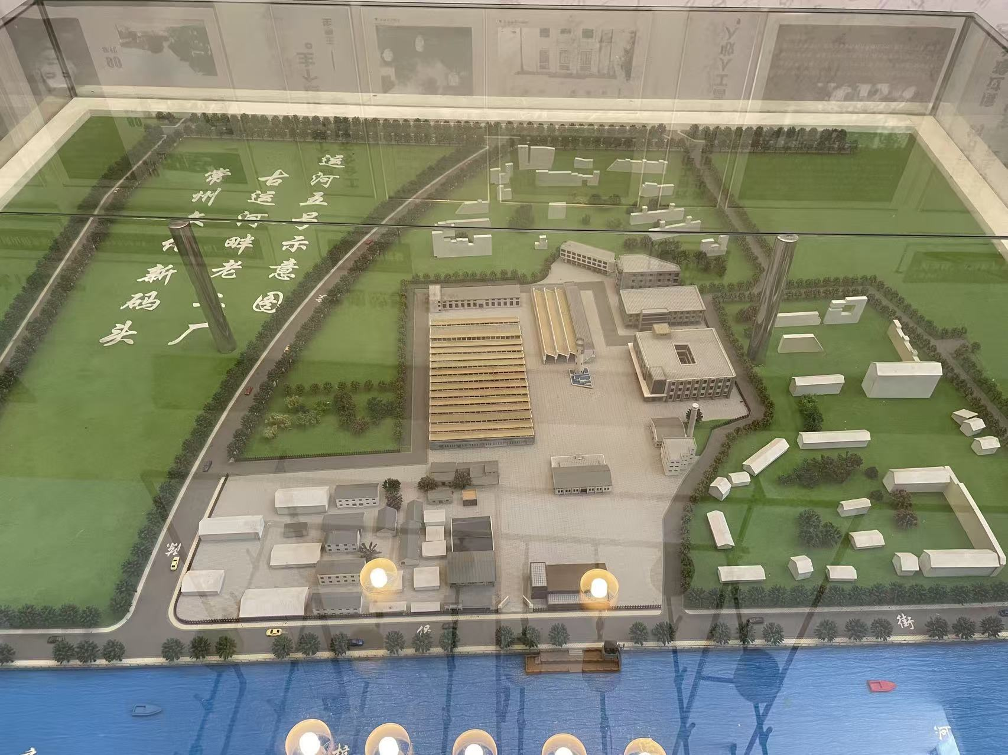
current situation overview

Slide 19
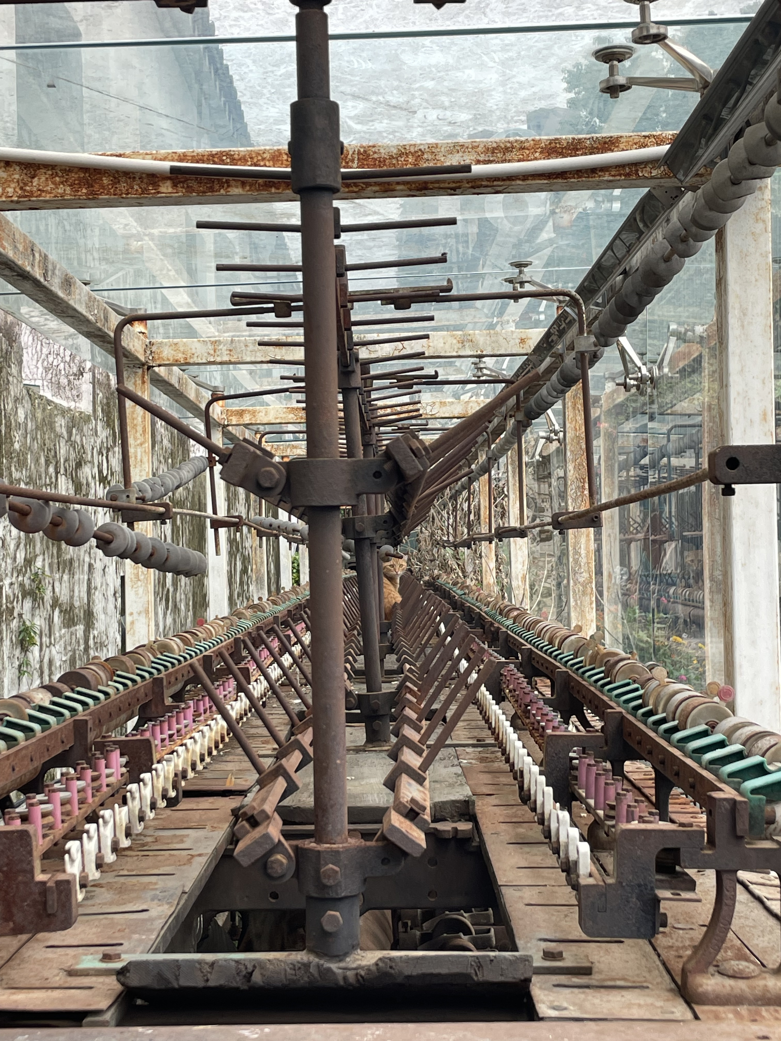
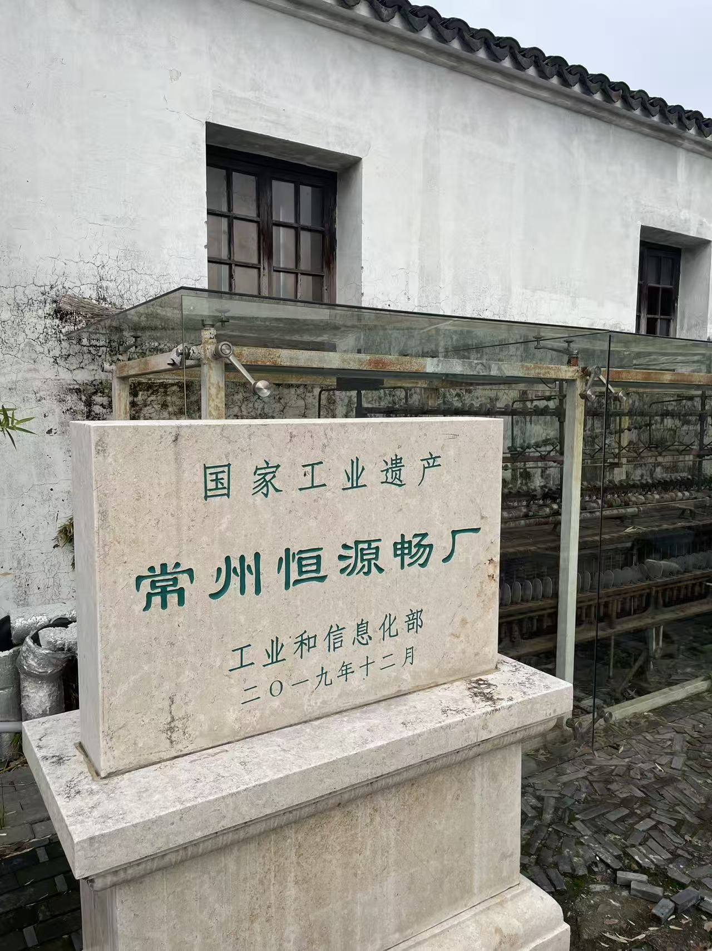
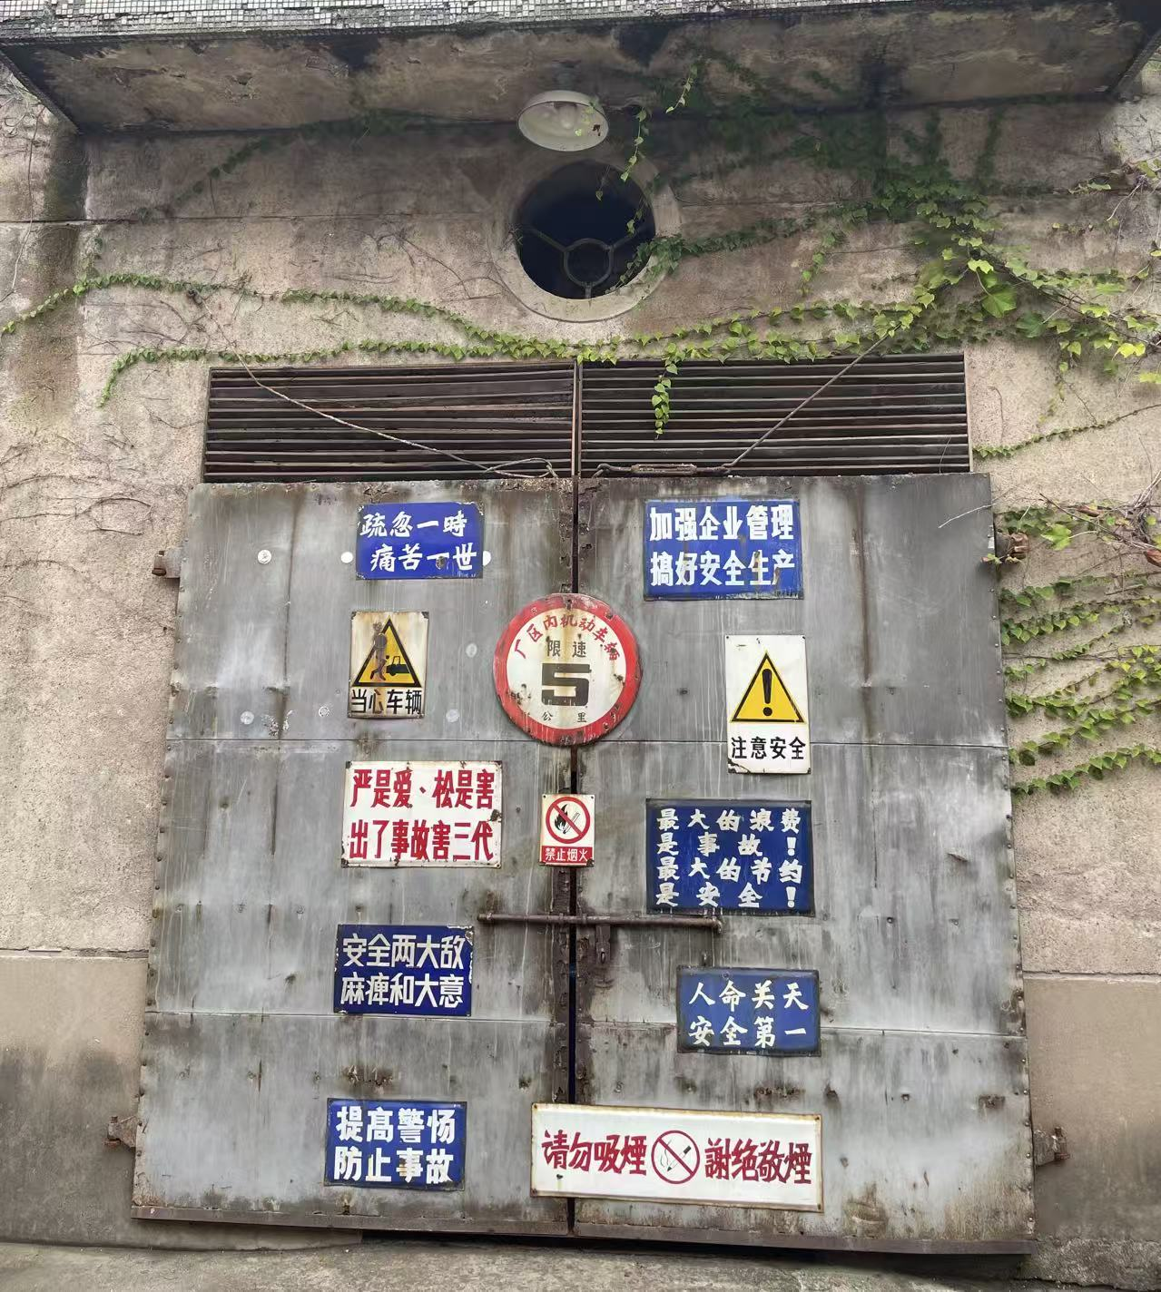
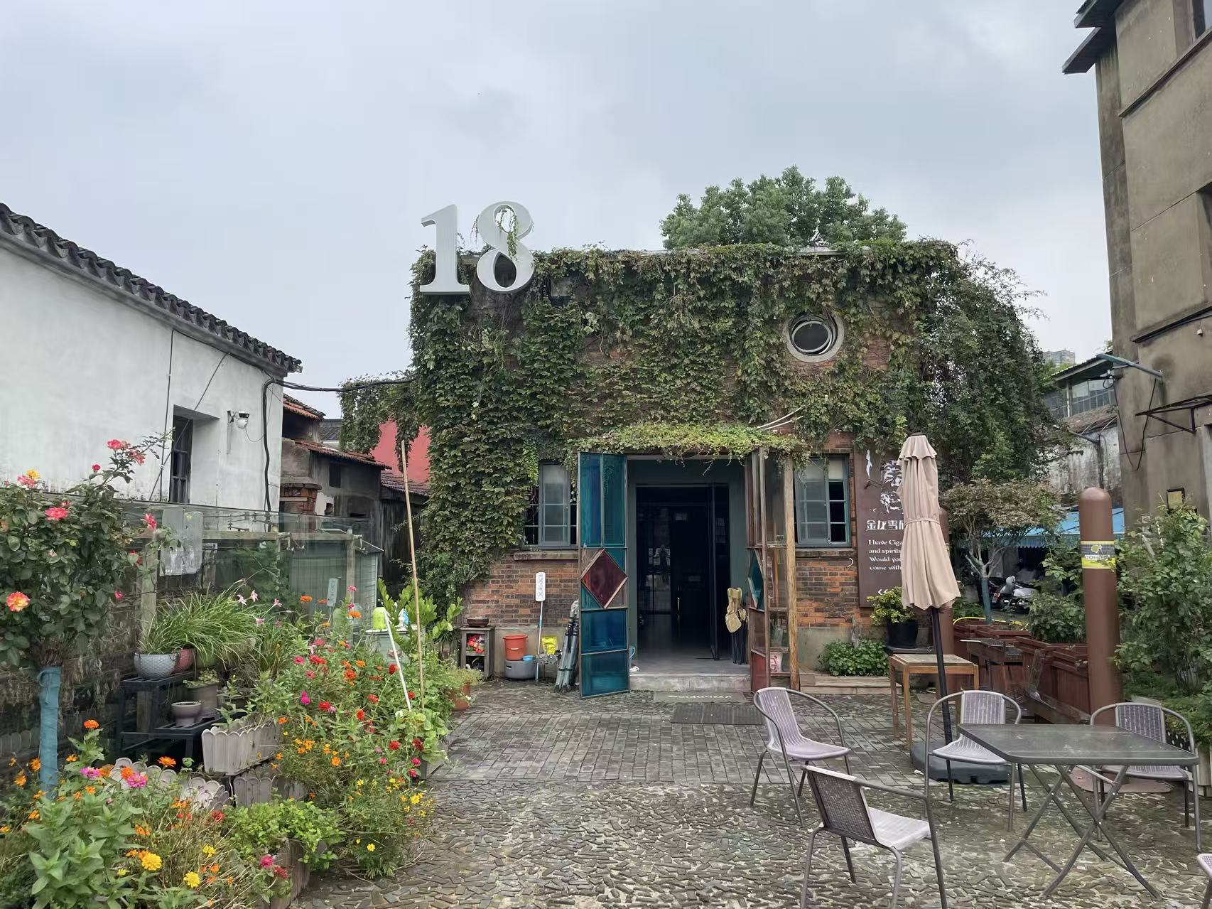
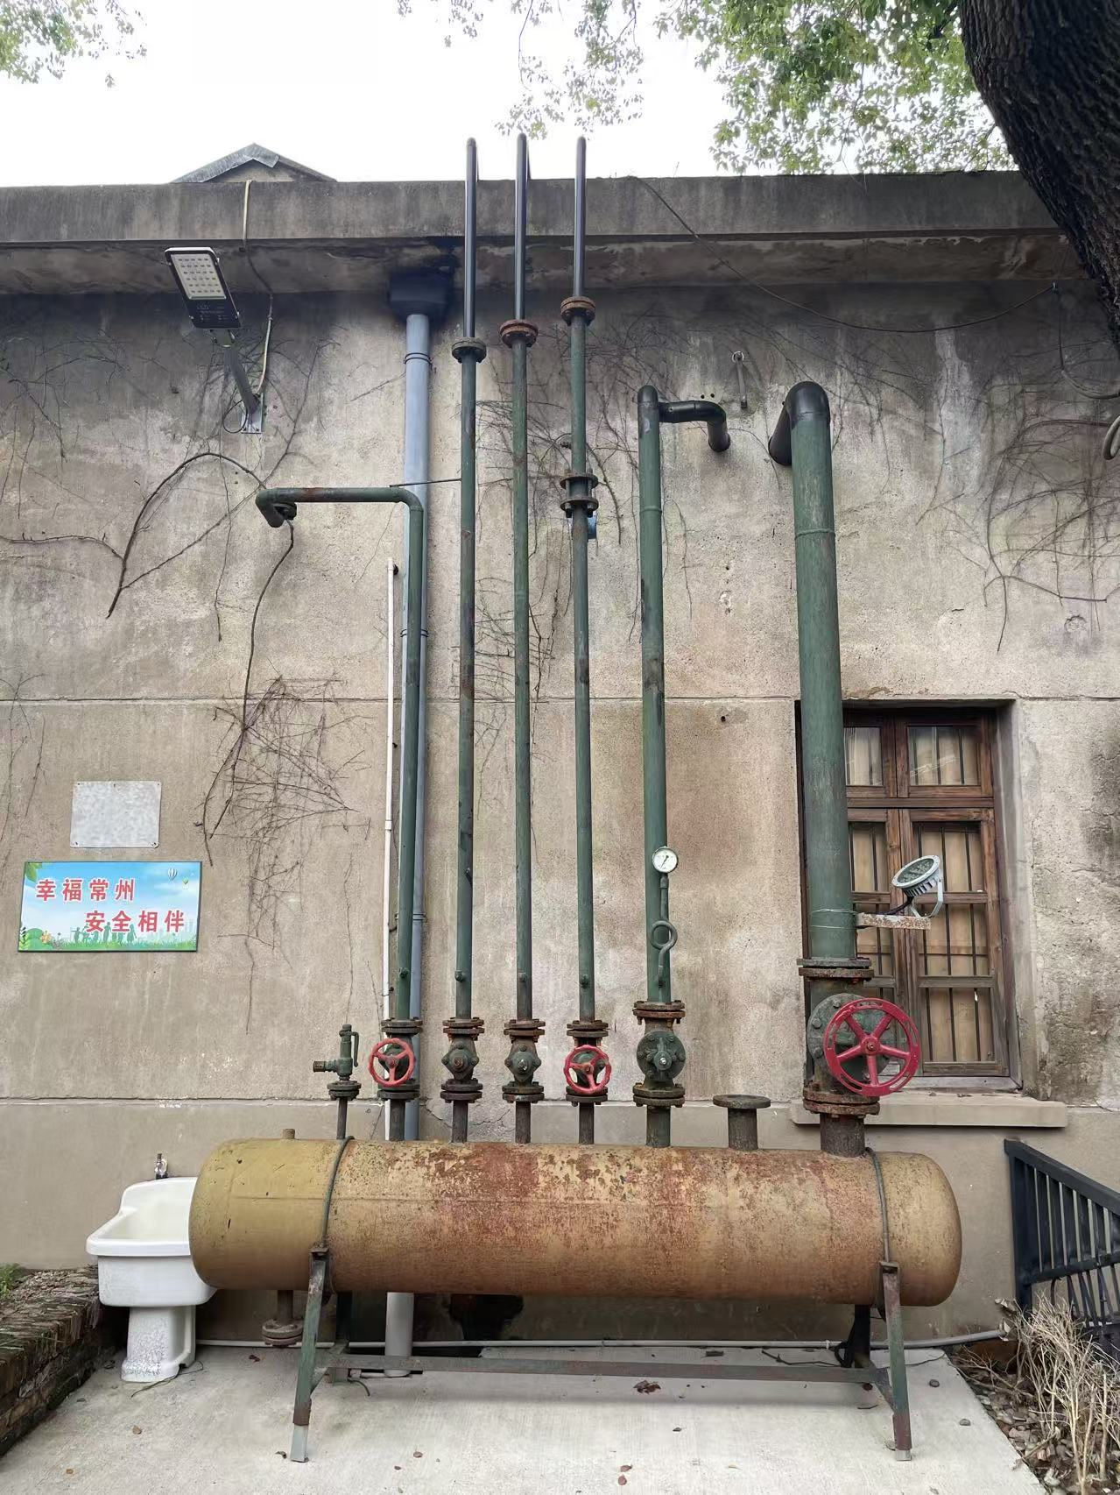
Conduct research on the Changzhou Hengyuanchang and its surrounding areas
scene

Slide 20
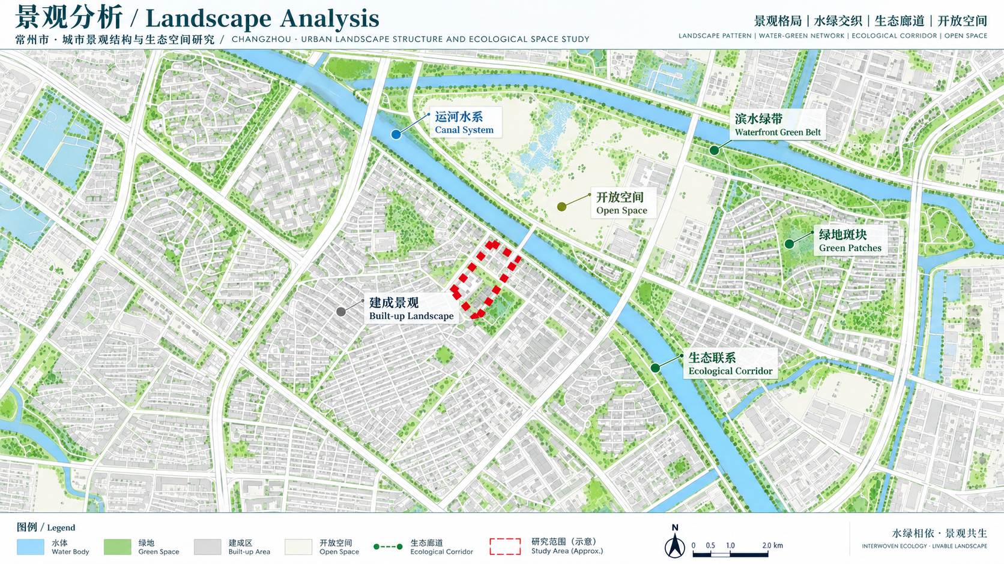

Slide 21
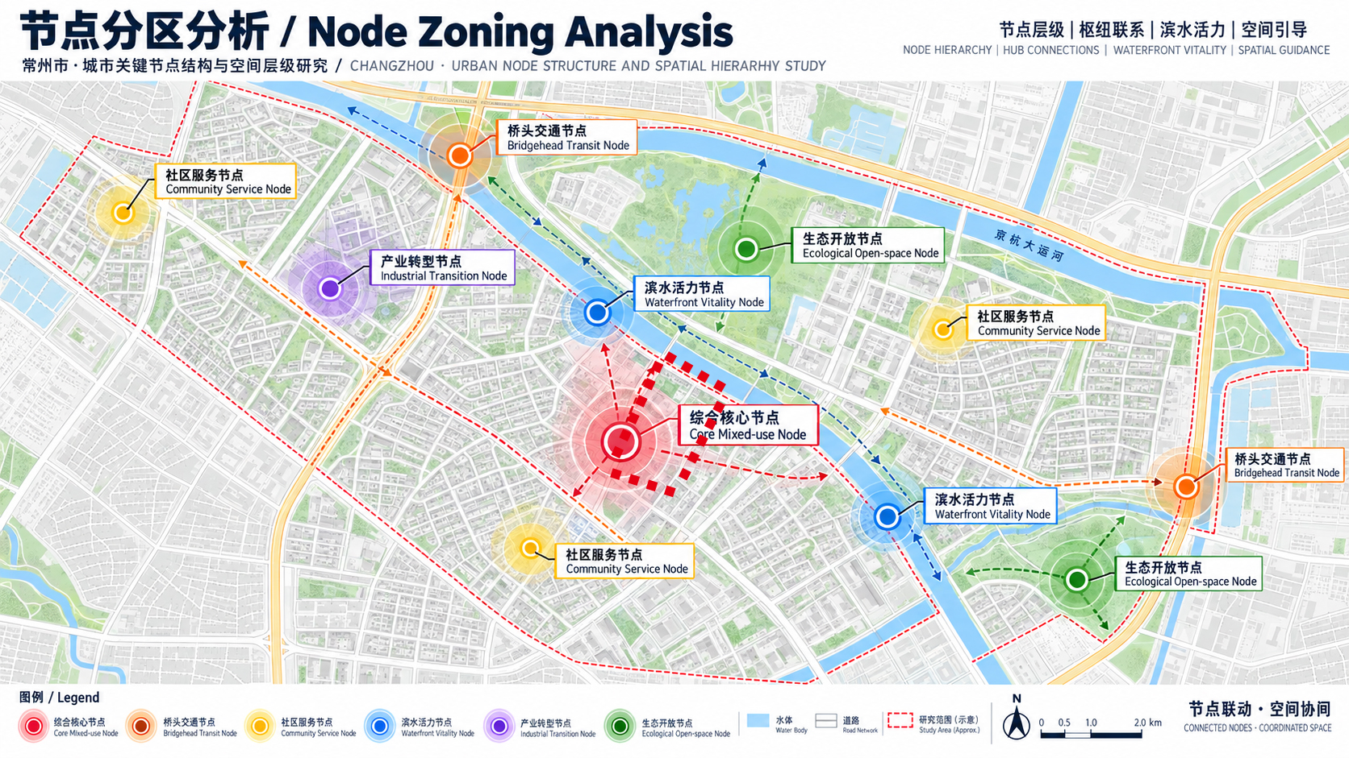

Slide 22
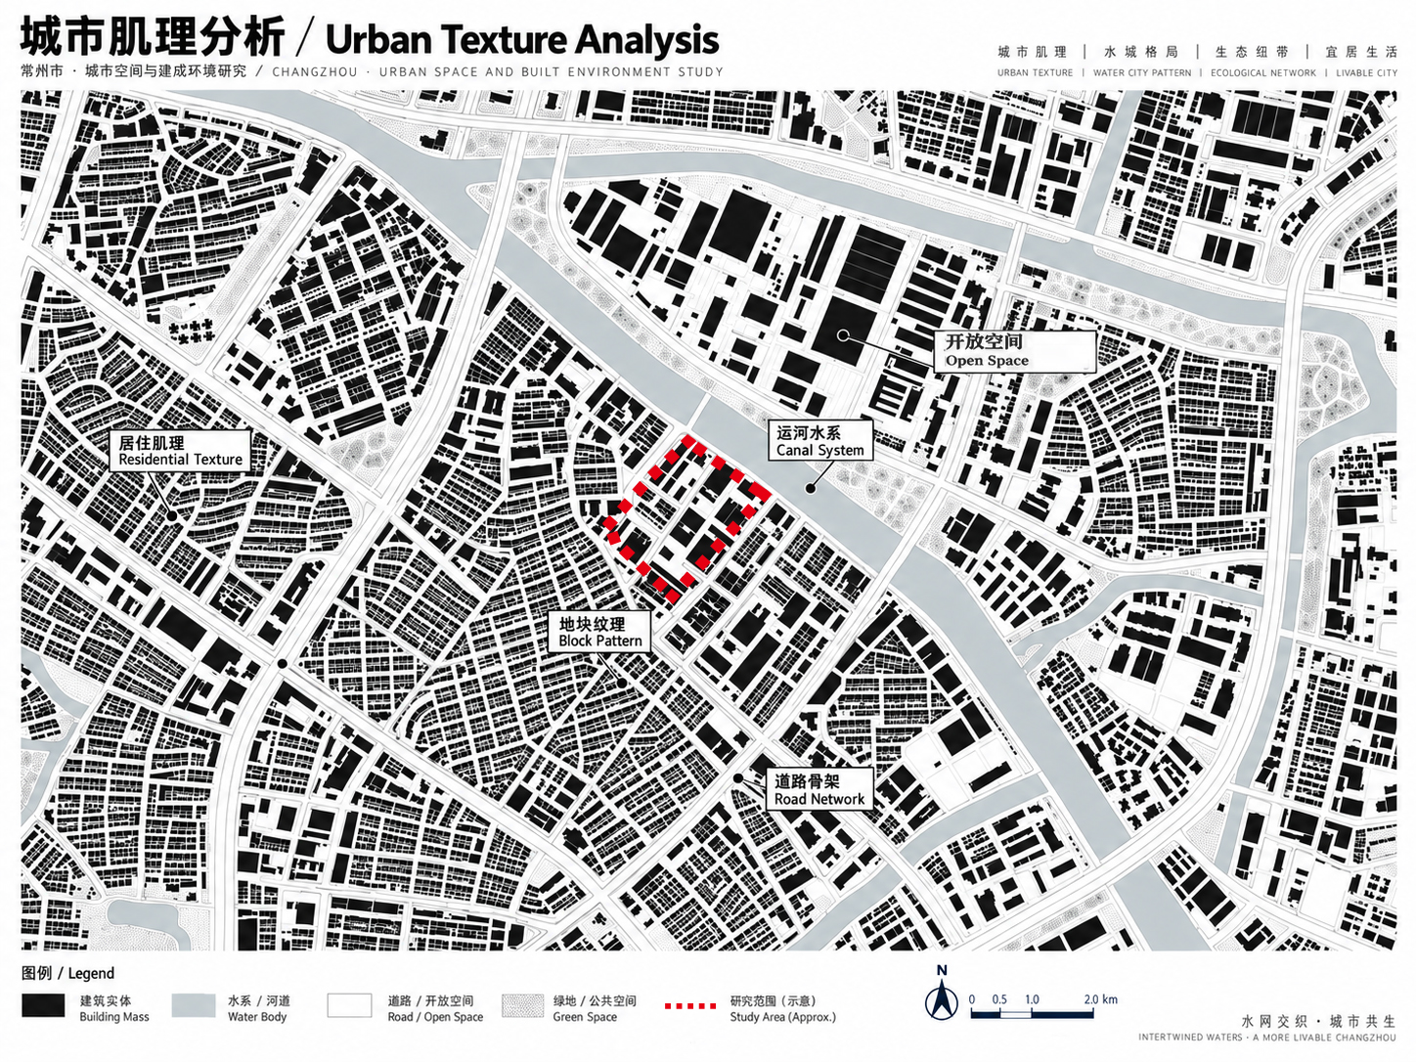

Slide 23
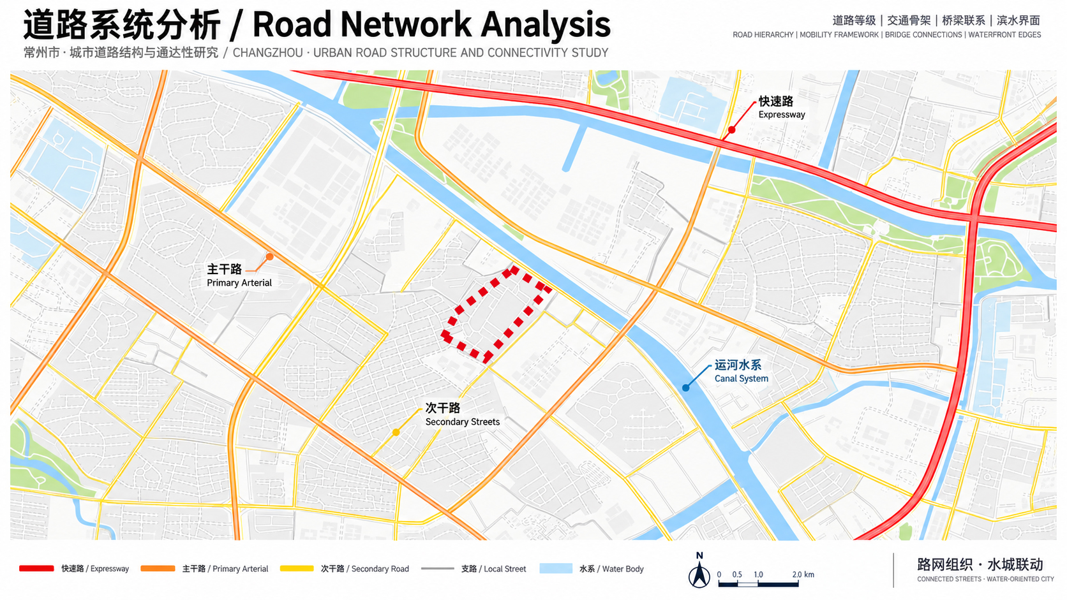

Slide 24
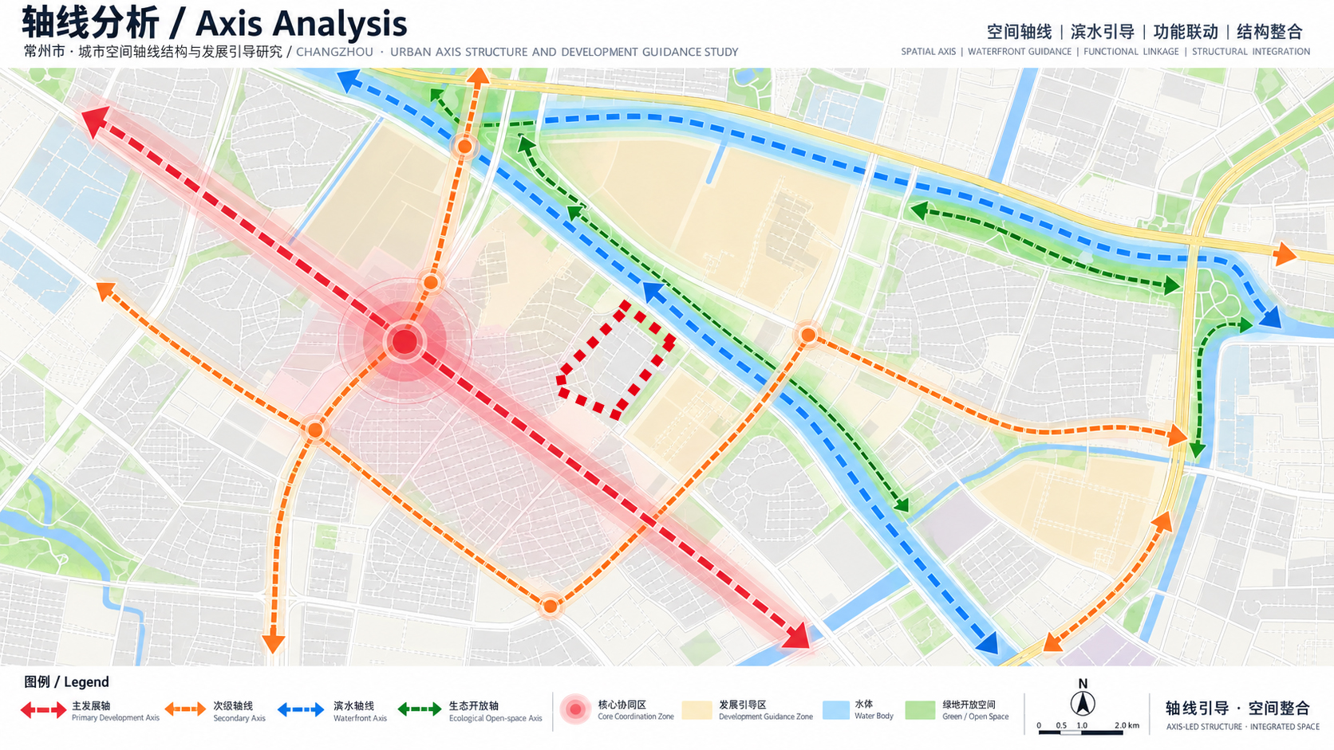

Slide 25
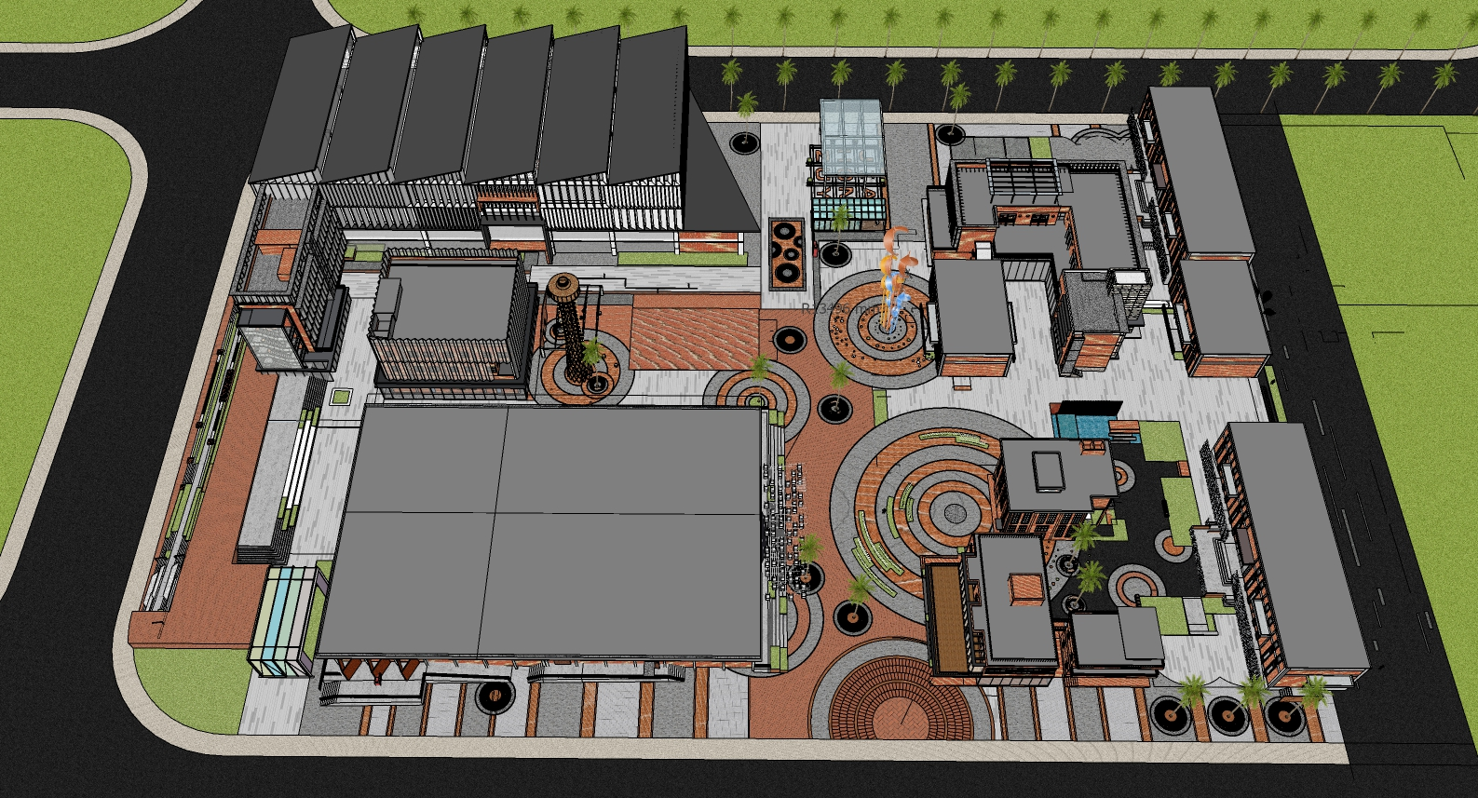

Slide 26
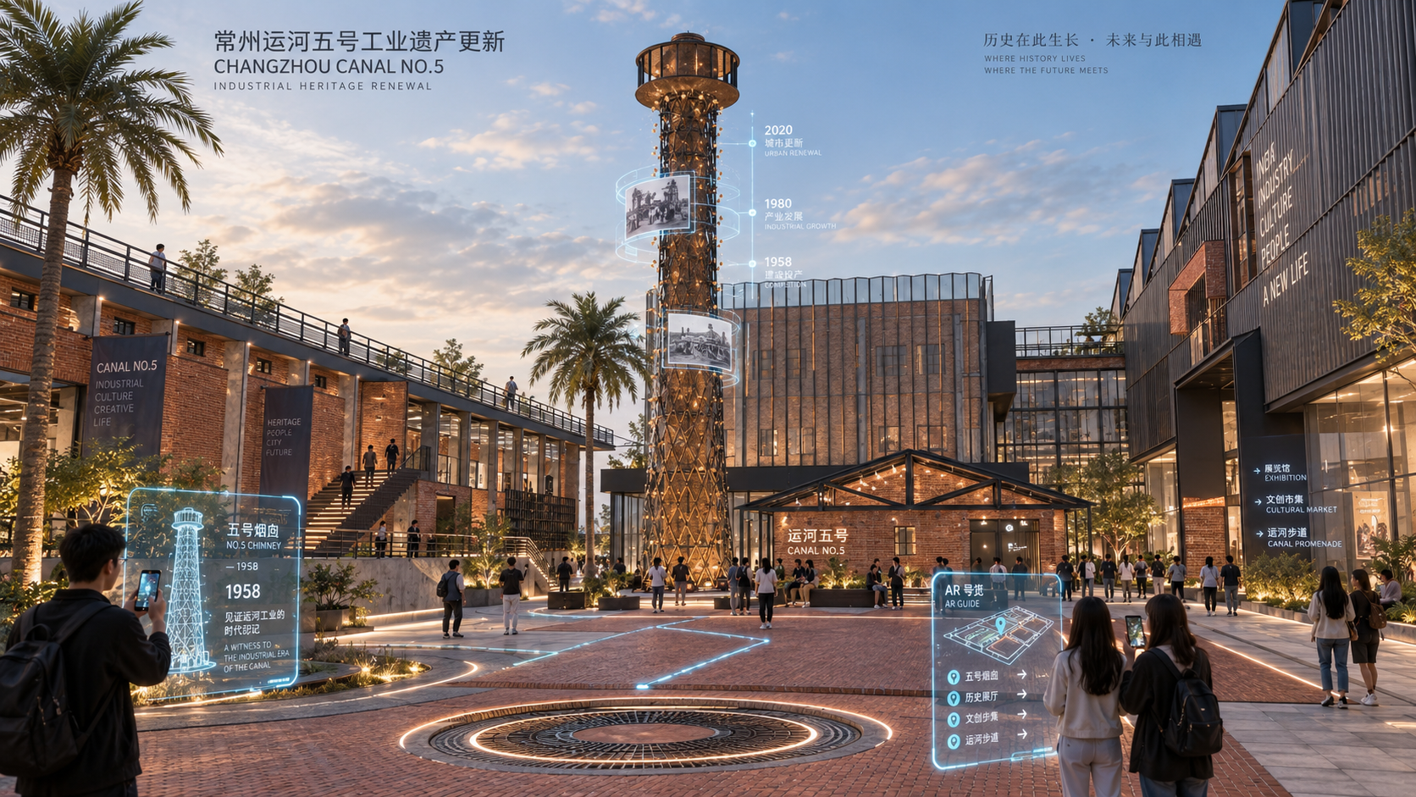

Slide 27
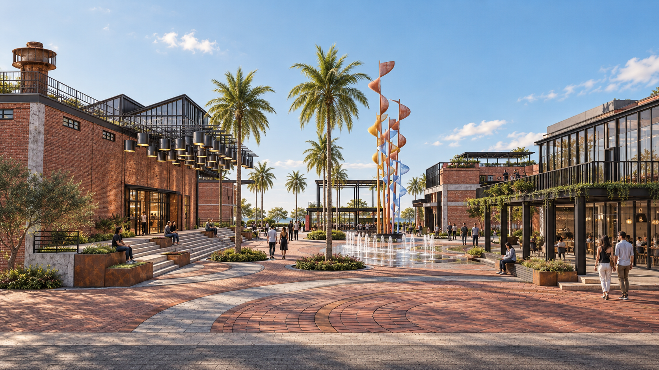

Slide 28
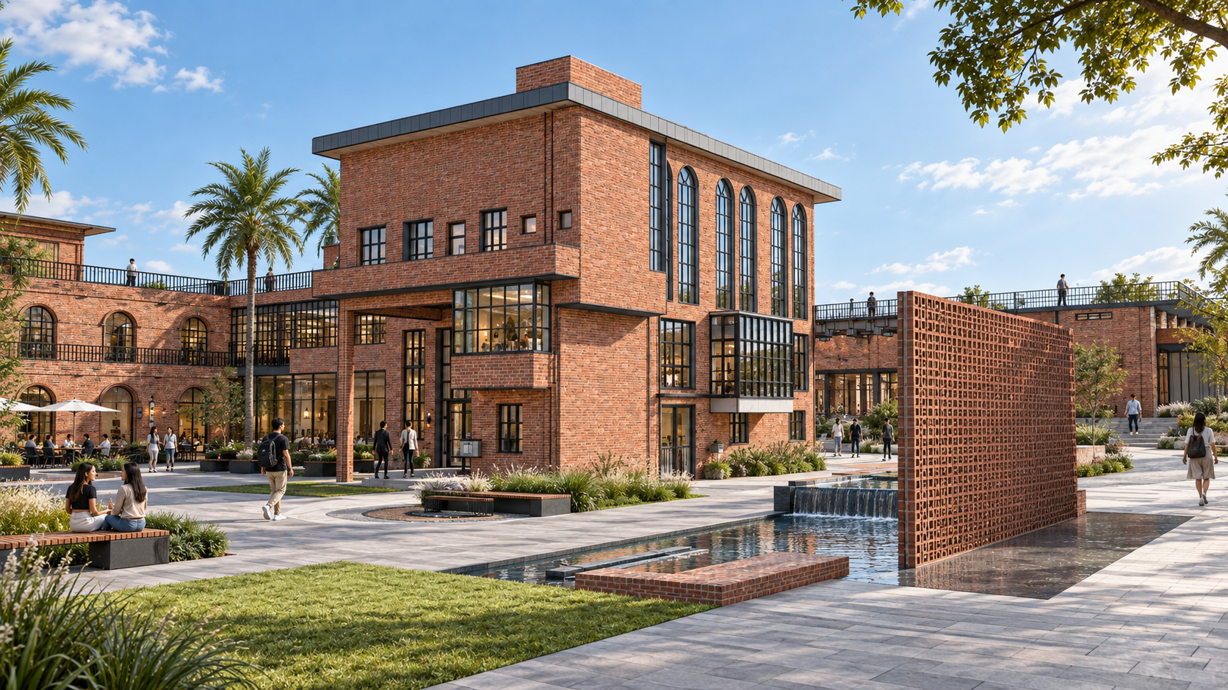

Slide 29
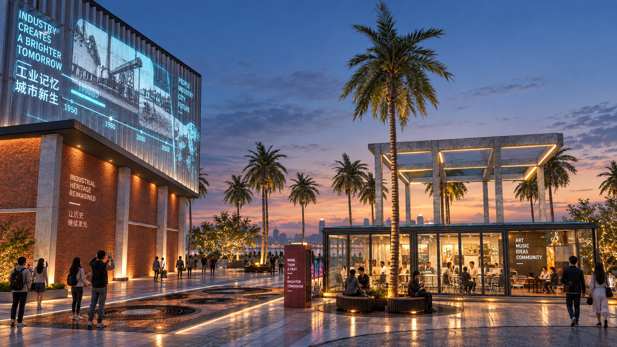

Slide 30
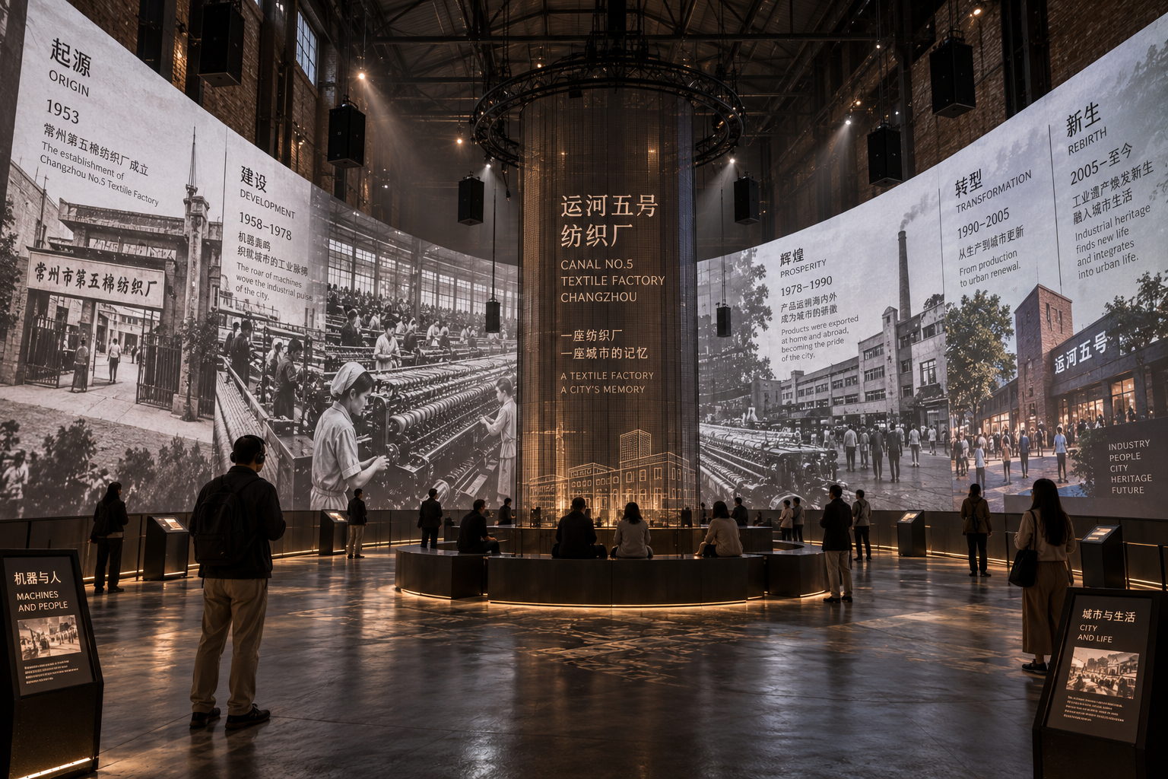

Slide 31
