Slide 1
Principles of universal design in the formation of public parks.
Reeves
Notes:
<номер>

Slide 2

01 Introduction
With the advancement of society and the development of age-friendly city initiatives, a growing body of research has focused on understanding the needs and experiences of various age groups in urban public spaces. Community parks, serving as essential components of urban public realms, play a critical role in promoting residents' physical and mental well-being while strengthening social cohesion.
However, accelerated urbanization and demographic shifts have exposed significant challenges in traditional community park design: static zoning configurations often result in inefficient space utilization and frequent intergenerational conflicts. Public spaces in established neighborhoods increasingly fail to accommodate diverse activity requirements and safety needs across generations.
To address these limitations, this study proposes innovative design principles for age-inclusive community parks alongside adaptive design methodologies. These approaches enhance comfort and inclusivity through spatial flexibility and multifunctional design. Focusing on Hongmei West Village Community Park in Changzhou, this project investigates the integration of universal-access principles with adaptive design strategies to improve functionality and accessibility in existing urban community spaces.
Notes:
<номер>

Slide 3

02 Research questions
1. How park spaces can meet the basic needs of different age groups？
2. How adaptive design improves flexibility？
3. What are the priority strategies for the renovation of old communities?
Notes:
<номер>

Slide 4
03 Theoretical basis
01. Theoretical foundations of environmental behavior
03. Theoretical basis of adaptive design
This theory emphasizes the interaction behavior between humans and the environment, and how to guide the sharing behavior of users of different ages through design.
The theory takes adaptability as the core, and proposes that parks need to adapt to population density changes, climate fluctuations and use time changes.
02. Theoretical foundations of spatial justice
04. Theoretical basis of the concept of age-friendly cities
This theory focuses on equity and accessibility in urban spaces, advocating for prioritizing the inclusion of all age groups, especially vulnerable groups, in park design.
This theory proposes that age-friendly frameworks should integrate communities, health systems, and environments to create inclusive spaces that promote intergenerational integration.
Notes:
<номер>

Slide 5
04 Theoretical Connection Framework
Spatial justice
2
Guided interactive design
Ensure fair realization
Environmental Behavior
1
3
Adaptive design
Integrated framework design
Dynamic adjustment is available
4
All-age friendly framework

Slide 6
05 Design methodology
All-round demand perception
Theory is integrated into design
Adaptable and flexible build
1.Analysis of space requirements
2.Behavior map construction
3.Emotional needs mining
1.Inclusive design circle
2.Behavior-guided design matrix
3. Technology-enabled design
1.Step-by-step creation strategy.
2.Space design management
3.Adaptive reserved space

Slide 7


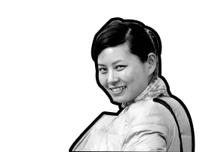
06 Investigation and analysis
"The old guys are always disturbed by pedestrians when playing chess" - Uncle Chen, 69 years old
"There are too few sun seats in winter, and the plastic chairs are easy to overturn" - Grandma Wang, 76 years old
"I can only step on the tree altar when my baby is playing on the slide" - Ms. Li, 32 years old

Slide 8
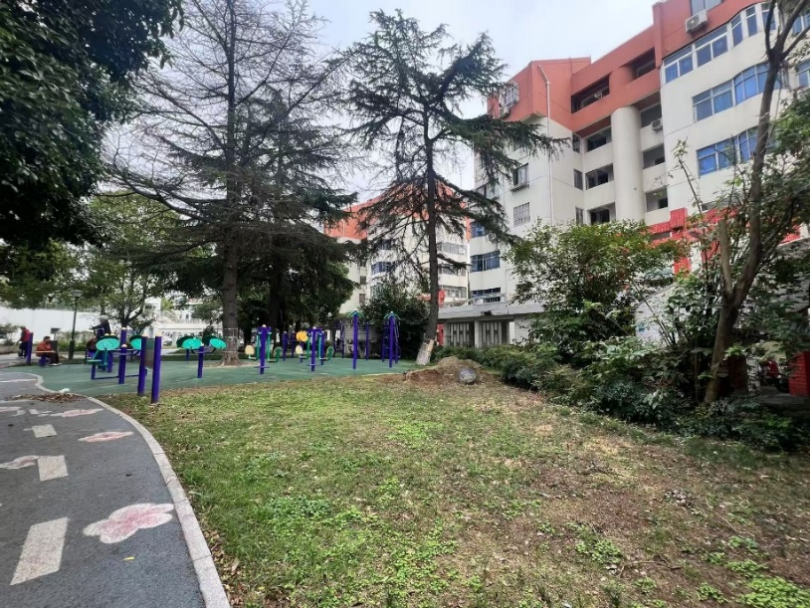

06 Investigation and analysis
Paving fragmentation and stagnant water
Insufficient illumination at night
People and vehicles are mixed
The ground is slippery
The steps are not matched with ramps
Few rest areas
Notes:
<номер>

Slide 9
06 Investigation and analysis

Slide 10
07 Summary and design points
Core summary
conclusion
1. Intergenerational conflict is the biggest pain point
2. Safety hazards have age characteristics
3. The memory carrier is an emotional bond
Design principles
principle
1. Safety support
2. Space activation
3. All-age design
4. Place memory
Facility renovation
facility
Notes
1. Steps of different heights
2. Benches that do not correspond to the height
3. Dark space
4. Dilapidated walls
essentials
1. Pay attention to safety design
2. Barrier-free details in place
3. The lighting system should be in place

Slide 11
08 Thesis charts

Slide 12
Research Methods
Literature Review and Theoretical Integration Method
A literature review is a method that systematically sorts out relevant literature and presents the current research status and gaps. Building on this, the theoretical integration method is a tool that integrates relevant theories to enhance explanatory power or promote innovation, and the two are complementary to each other.
Mixed Research Method Combining Qualitative and Quantitative Approaches
The mixed research method integrates qualitative research (focusing on qualitative insights and interpretation of meaning) and quantitative research (focusing on statistical data analysis and verification of patterns). The two complement each other's strengths, enabling more comprehensive and accurate addressing of research questions.
Field Research Method
The field research method is an approach where researchers immerse themselves in the research site, directly engage with the research subjects through participant observation, in-depth interviews, and other means, collect first-hand qualitative data, so as to truly understand the essence of the research phenomenon and its contextual connections.
Interdisciplinary Validation Method
The interdisciplinary validation method is a research approach that integrates theories, perspectives, or research methods from different disciplines, conducts multi-dimensional verification of the same research conclusion or phenomenon, makes up for the limitations of a single discipline, and enhances the reliability and universality of the conclusions.

Slide 13
Design Principles
Spatial Interconnection Principle
Emphasizes the connection and link between different spaces, breaks separation through reasonable layout, ensures smooth circulation, and realizes efficient linkage and coordinated utilization of spatial resources.
Functional Adaptability Principle
Requires design or planning to fit usage needs, flexibly adapt to scene changes, balance practicality and expansibility, and meet functional requirements at different stages.
Ecological Adaptability Principle
Focuses on harmonious coexistence with the natural environment, reduces ecological interference, follows environmental laws, and achieves sustainable development and ecological balance.
Emotional Resonance Principle
Centers on users’ psychological experience, conveys warmth through scene creation and detailed design, evokes emotional identification and a sense of belonging, and enhances usage happiness.
Safety and Comfort Principle
Takes ensuring users’ physical and mental safety as the foundation, balances sensory comfort and usage convenience, and creates a risk-free and pleasant space or usage environment.

Slide 14
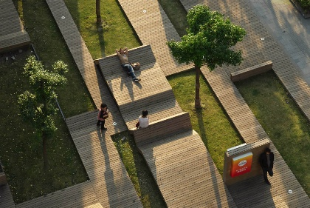
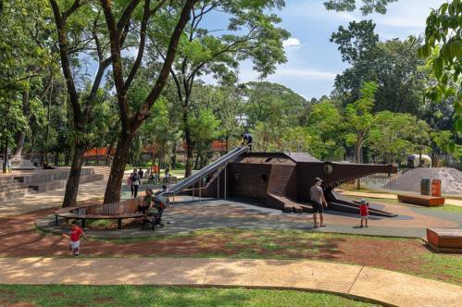
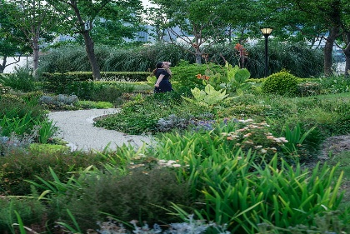
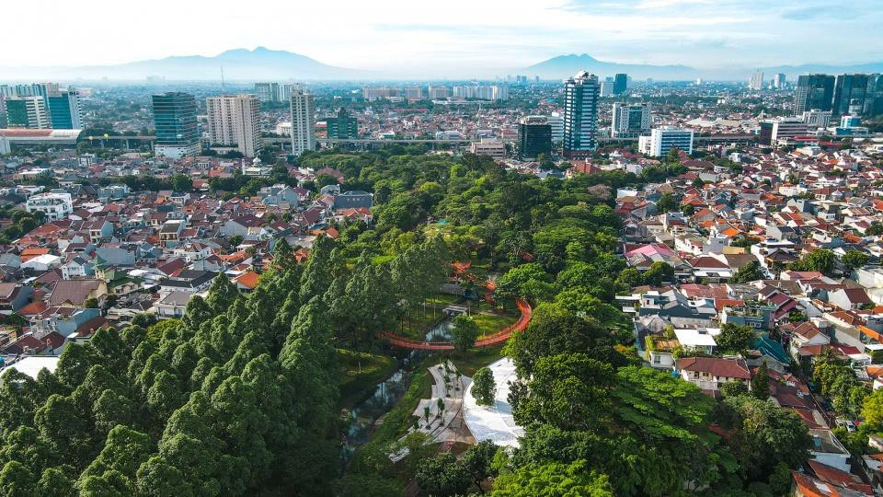
Universal Design Principles for Public Parks
The nature of human-centered design
Studies show that successful park design must place "people" at the core, meeting users' functional needs while addressing their psychological and emotional demands.
Multi-dimensional design considerations
Public park design should include three key dimensions: physical (spatial scale and form), environmental (ecological sustainability), and social (intergenerational integration).
All-age friendly design direction
Contemporary park design needs to break the limitation of serving a single group and establish a trinity design principal system of "structural-normative-emotional".
Environmentally equitable design ethics
Latest research trends show that public park design has shifted from pure landscape beautification to pursuing "environmental justice", emphasizing the fair social distribution of public service resources.

Slide 15
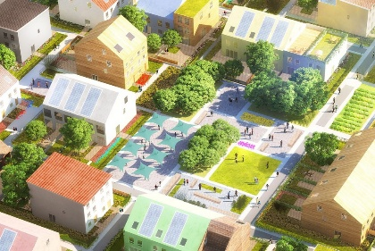
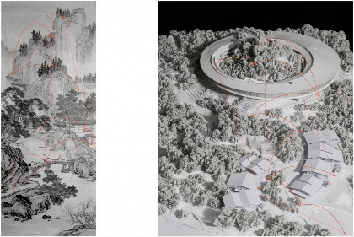
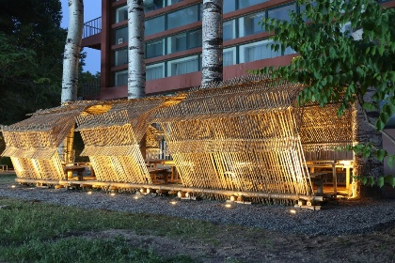
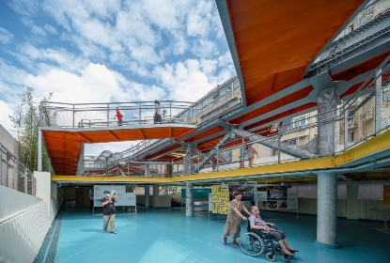
The nature of human-centered design
Accurately adapt to diverse needs
Abandon standardization; explore needs via surveys, balance public habits and special group traits, and align layout, function and logic for universal inclusiveness.
Focusing on Full-Process Experience
Cover the entire contact-to-use cycle; reduce cognitive costs, enhance fluency, predict pain points, simplify links, optimize logic, and eliminate hidden barriers.
Aligning with Cultural and Spiritual Identity
Root in regional culture; extract core symbols (e.g., folk customs) into modern design language. Respect cross-cultural customs and aesthetics to convey connotations and arouse emotional/identity recognition.
Empowering Long-Term Development
Go beyond current needs; use design to guide positive behaviors and ability improvement, boost habits and core competencies, and support vulnerable groups' integration for growth and value realization.

Slide 16
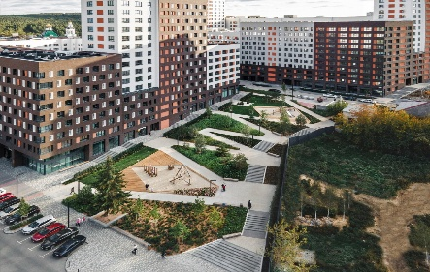
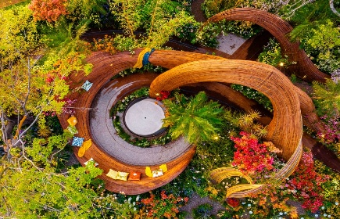
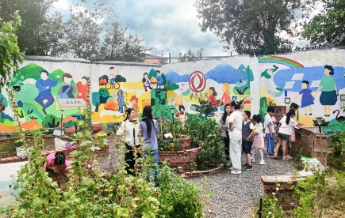
Multi-dimensional design considerations
Physical Space Dimension
With "accessibility for all ages and functional adaptation" as the core and serving as the basic carrier, the design focuses on barrier-free access, versatility, and comfort.
Ecological Environment Dimension
Guided by the principle of "local adaptation and sustainable coexistence", it takes a low-maintenance, high-resilience, and educational micro-ecosystem as the foundation. Native species are selected for vegetation, balancing biodiversity with four-season landscapes.
Aiming at "group integration and emotional connection", it focuses on social needs and breaks down group barriers. Shared spaces and parent-child facilities are created to promote intergenerational integration; regional cultural and community memory symbols are incorporated to strengthen the sense of place identity.
Social Interaction Dimension

Slide 17
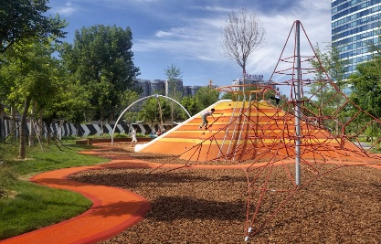
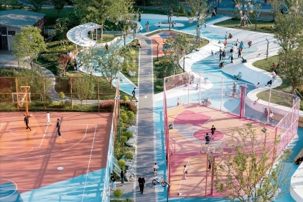
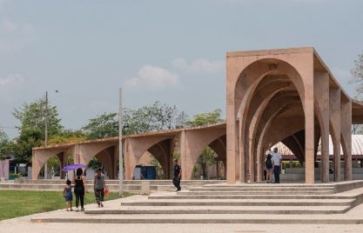
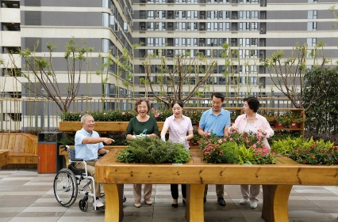
All-age friendly design direction
Children: Safety and Exploration Enlightenment
Safety + Exploration + Growth. Ensure safety through rounded corners and cushioned flooring; design graded exploration activities to match children’s ages; set up a parent supervision area and integrate enlightenment elements into the space.
Youth: Vitality and Social Adaptation
Diversity + Social Interaction + Flexibility. Plan sports and fitness zones; install movable facilities to enable scenario reuse; set up social nodes adjacent to sports areas.
Middle-aged Adults: Companionship and Personal Leisure
Collaboration + Regulation + Convenience. Create shared spaces between children’s and elderly areas; reserve quiet leisure zones and light fitness areas; equip with convenient facilities to reduce costs.
Elderly: Safety and Social Empowerment
Barrier-free Access + Comfort + Social Interaction. Establish a full-process barrier-free system; densely place protective resting seats along traffic routes; plan low-intensity activity areas and social nodes.

Slide 18
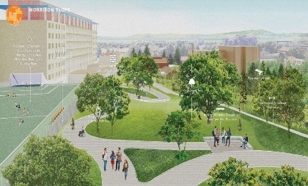
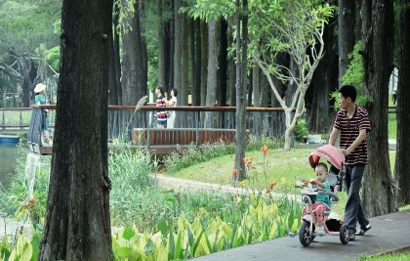
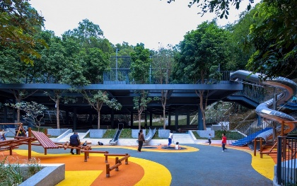
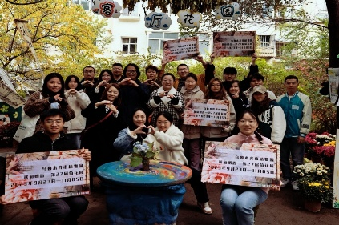
Environmentally equitable design ethics
Equity in Accessibility
The Ethical Bottom Line for Breaking Physical and Spatial Barriers. As the fundamental ethics of environmental equity, its core is to ensure undifferentiated access and use of spaces for all groups.
Equity in Functional Adaptation
The Ethical Core of Balancing Commonalities and Differences. Its core is to guarantee that each group has access to adapted scenarios, and to reject the replacement of diverse needs with mainstream ones.
Equity in Resource Allocation
The Ethical Balance Between Balanced Allocation and Preferential Support. Its core is to avoid the concentration of high-quality resources and strengthen support for vulnerable groups.
Equity in Participation Rights
The Ethical Extension of Involving Diverse Stakeholders, The deep-seated ethics lies in ensuring that users participate in the design process. It requires establishing diverse participation mechanisms, incorporating opinions from various groups, and paying attention to silent groups.

Slide 19
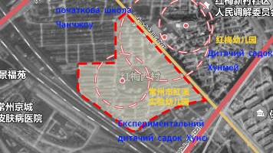
09 Preliminary analysis/site selection
Site selection
The site of this project is very special, with a large number of residents in the neighborhood. There is also a kindergarten full of vigor and vitality in the community, which is the cradle of children's enlightenment and education, and every day you can hear the innocent laughter and childish songs of the children.

Slide 20
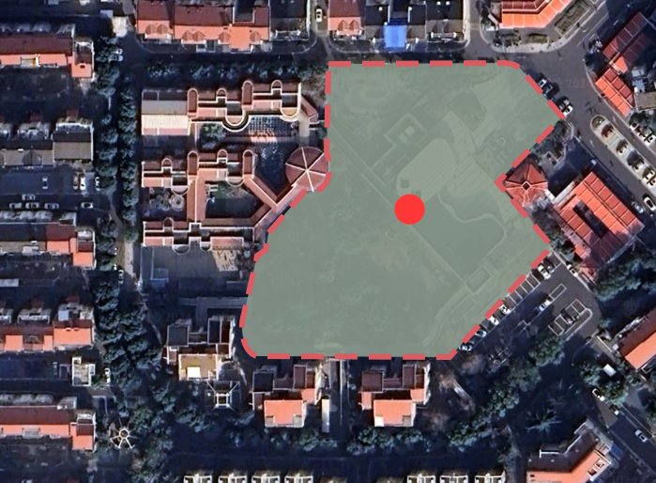
10 Preliminary analysis / site analysis
A brief introduction
The project is located in the community of Hongmei Changzhou City, Jiangsu Province, and is adjacent to the Hongxi Kindergarten. The people in the community have a wide age range covering all age groups, including the elderly, middle-aged, young and young at heart. Children grow up in kindergartens, young people chase their dreams, middle-aged people play a major role, and the elderly enjoy old age, and residents of all ages work together to build a harmonious and diverse community living environment, and the project will carry out its own planning and development in this context.
Notes:
<номер>

Slide 21
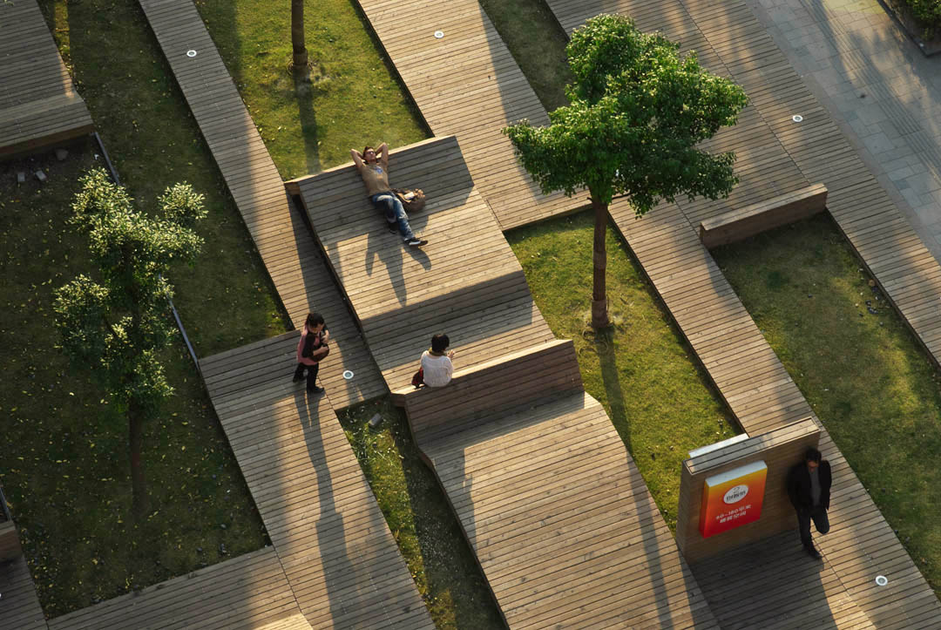
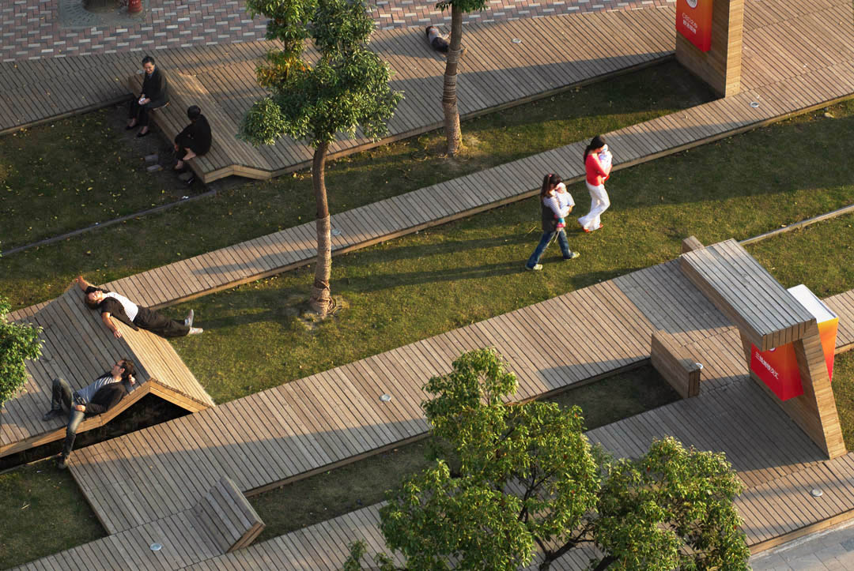
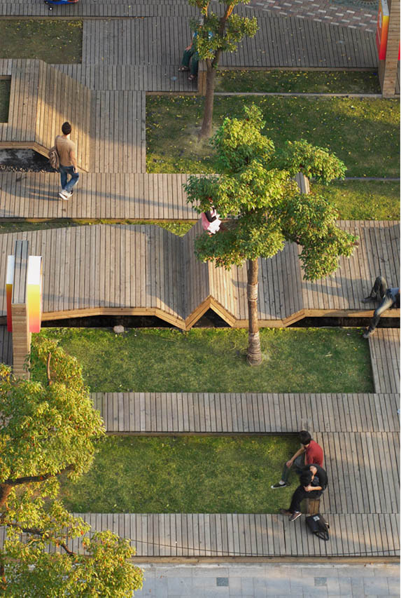
11 Album of analogues
This is a narrow attractive green area in the heart of Shanghai.
The designer used a folded wooden platform to create a public carpet that is suitable for both gathering and privacy.
To cover the entire surface, the designers used the ideal material - wood, which is both flexible and friendly, and also retains the natural conditions of its time as it ages. Where the boards are raised, the internal ecological space is created by the interweaving of grass and trees. In this way, the designer determines in advance the places where people can gather, relax and even play sports on a skateboard, forming a public place that accommodates both gatherings and privacy.
KIC PARK
https://architizer.com/projects/kic-park/

Slide 22
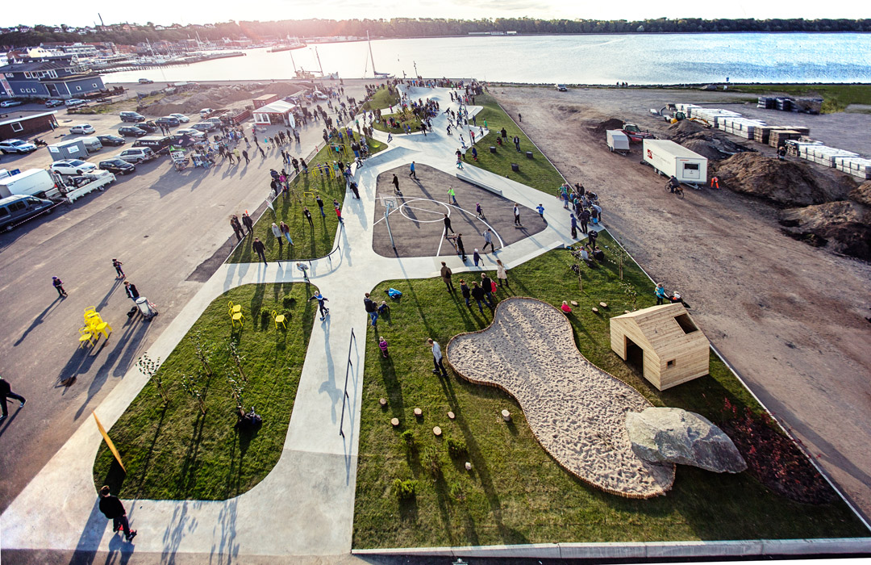
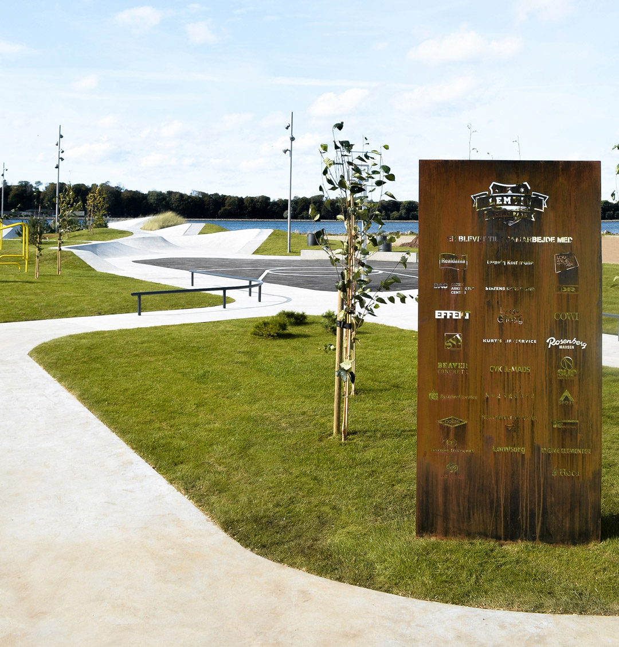
11 Album of analogues
LEMVIG Skatepark
https://www.archdaily.com/470077/lemvig-skatepark-effekt
The designer turned a piece of unused industrial land located in a picturesque area near the harbor into a desirable recreational area. With the concept of "skateboard + park", this recreational area has been transformed into a new multifunctional urban park area, which can adapt to the diverse needs of citizens of all ages and become a new popular social space.

Slide 23
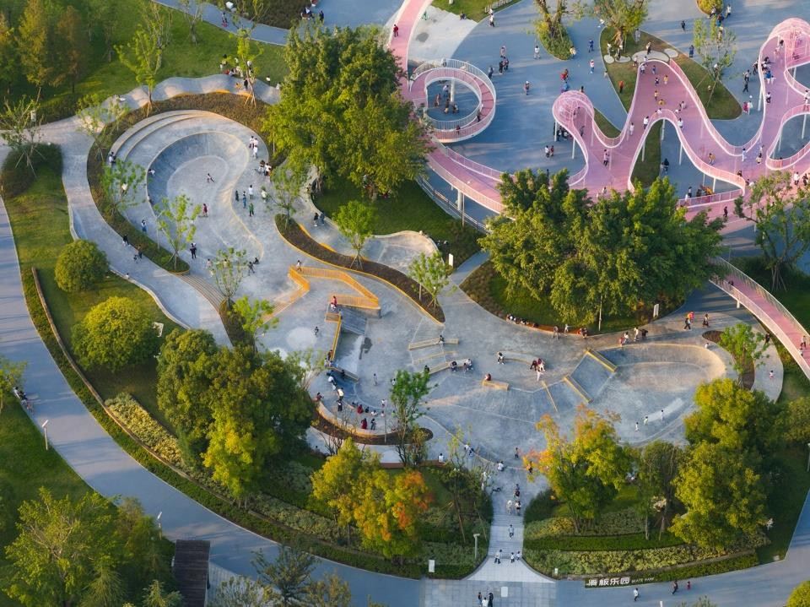
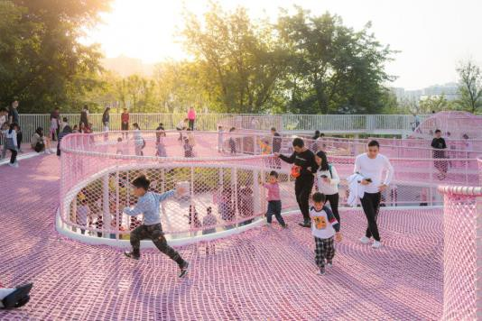
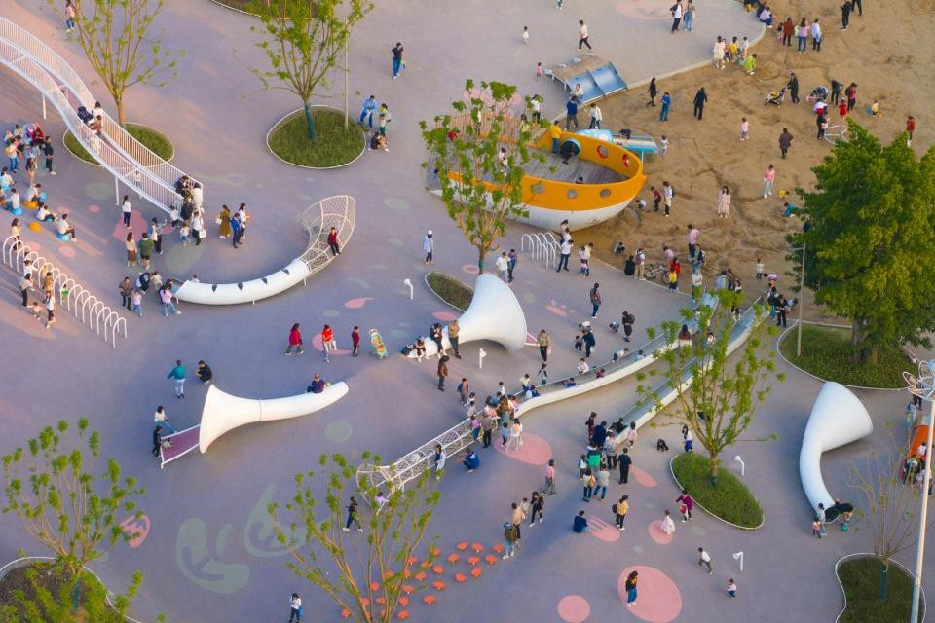
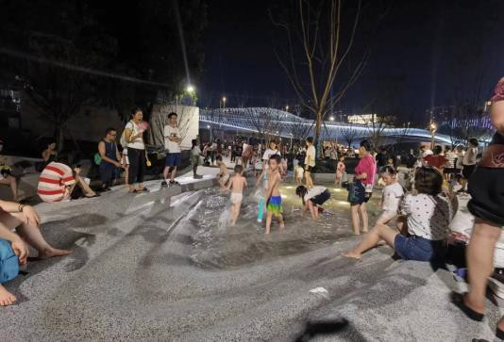
11 Album of analogues
Chongqing Longtang Lake Park
http://www.wisto.com.cn/projects.html?id=1732678173282693122/
The project area lacks a large children's entertainment and interactive park with a parent-child theme, so the design mainly focuses on interaction between people and the site to enhance the sense of user participation, among which the most important system is the children's activity area. Children's games are focused on the north and east side, the north side uses the elevation difference to form an interesting hill beach park and a fun shallow water park, the east side is the largest children's play area, because of the bright circle, a large climbing net, various fun swings, extra-long mountain slides, an exciting skate park, a huge circular theater and other children's facilities. Three theme parks - wetland, mountain and skate park - are connected into one play track to explore the strange and interesting.

Slide 24

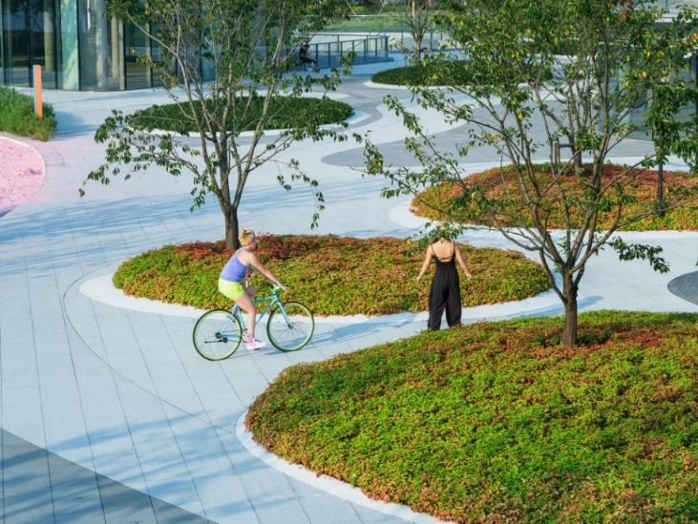
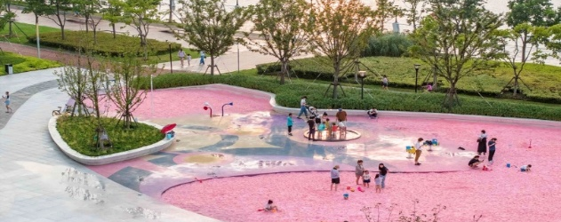
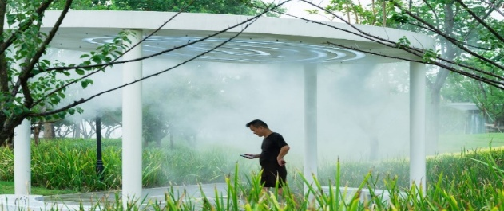
11 Album of analogues
In order to make up for the lack of places for social activity, the park had to include features of parent-child entertainment and family interaction. A key factor in the design was the connection to history, nature and providing a sense of free play.
The park includes a flower border design. In the plant space, the original large trees, Kelreiteria, Sycamorpha and Sapiens, are reorganized and arranged in such a way as to preserve them as much as possible. Based on the conservation of the original large trees, deciduous trees, consisting mainly of piacum, sapiens and sapiens, are planted by planting method to form a colored forest belt. Create a multi-level plant landscape space. As part of the original forest belt, cherry blossoms, red plums, begonias, myrtles, magnolias and other ornamental tree species are planted to enrich the changes of the four seasons, show different colors and enjoy the scenery in the four seasons.
Shanghai Qiantan Leisure Park renovation and upgrading
https://www.officemyp.com/

Slide 25
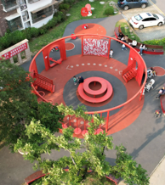
Community Rehabilitation of Caohu 2 District, Xiangcheng District, Suzhou, China
Relying on “all-ages sharing and emotional care,” the project creates a public space that not only meets the safety and exploration needs of children, but also takes into account the diverse needs of seniors, youth, and parents, creates an atmosphere of interactive community communication, and promotes “fun for all ages.”
summary
The Caohu community project transforms an old public space with a single function into a vibrant, shared place for all ages through design for all ages. The design comprehensively improves the quality of the space, enhances the sense of belonging and interactive experience of community residents, and realizes an organic combination of function and emotion.

Slide 26
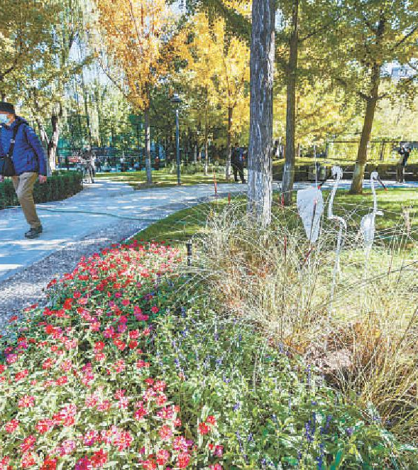
The outer garden of Ditan Park, Beijing
With a total area of 6.05 hectares, the park is an open city park for all ages with a natural and quiet garden valley and a magnificent and poetic ginkgo forest, as well as badminton courts, table tennis courts and children's play areas.
summary
The outer garden of Ditan Park is carefully constructed with the concept of friendliness for all age groups.
In terms of amenities, there are not only barrier-free access ramps and rehabilitation railings suitable for the elderly, but also interesting play areas for children, as well as badminton and table tennis courts to meet the fitness and exercise needs of young people.
Through this renovation, the Ditan Park outdoor garden has realized the integration of functions and landscapes for all age groups and has become a popular outdoor city park that can comprehensively meet the leisure and entertainment needs of citizens of all ages.

Slide 27
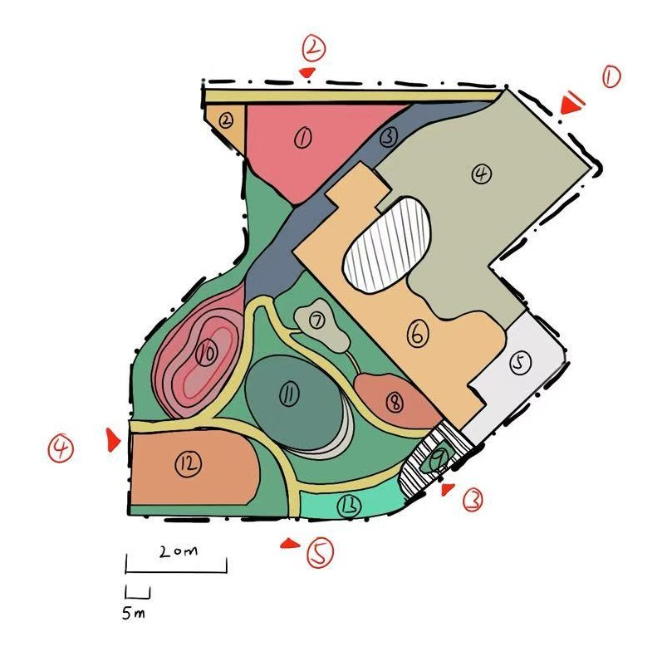
12. Scheme design
This is the rough design of this time, dividing the entire park into 12 pieces, which will be designed one by one.
The long scale is 20 meters, and the short scale is 5 meters

Slide 28
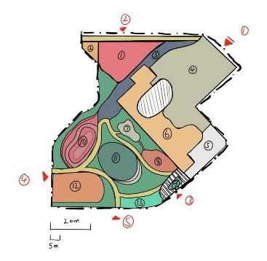
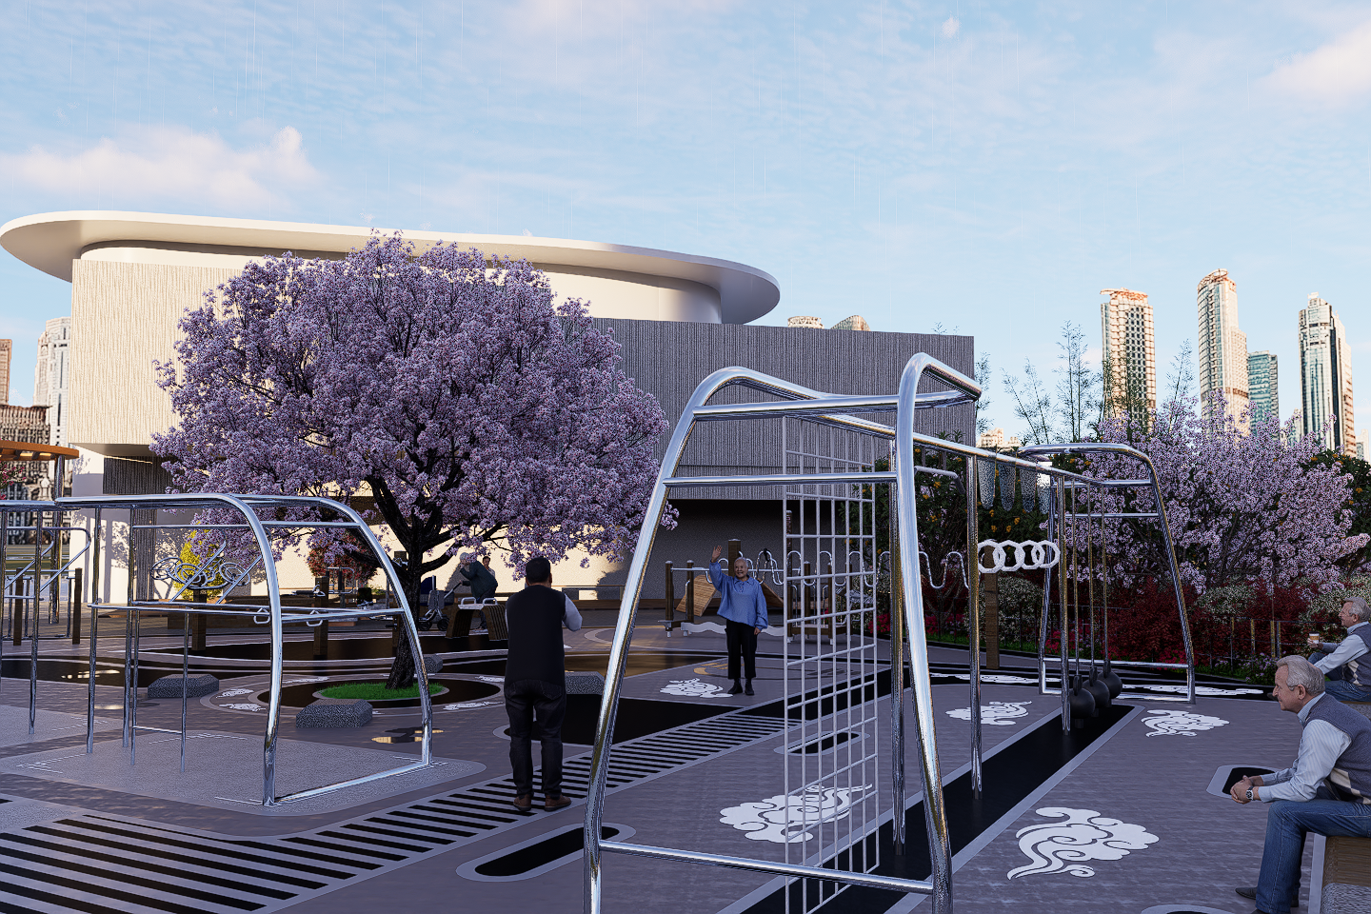
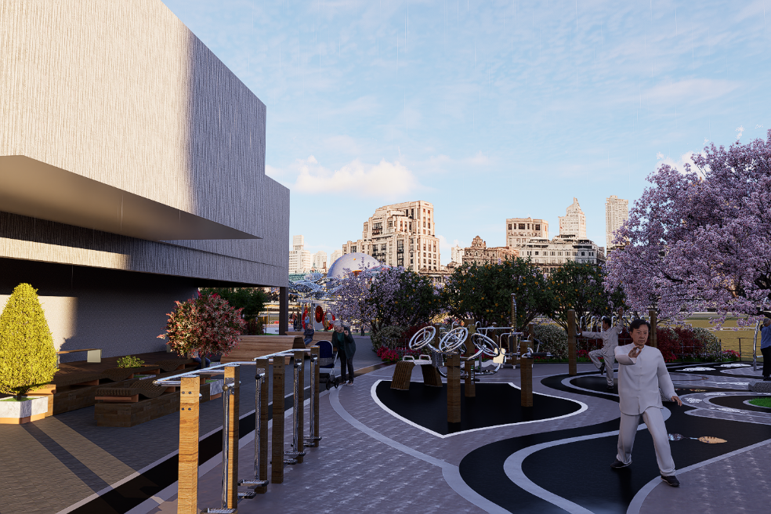
Region 1 Exercise area for the elderly

Slide 29
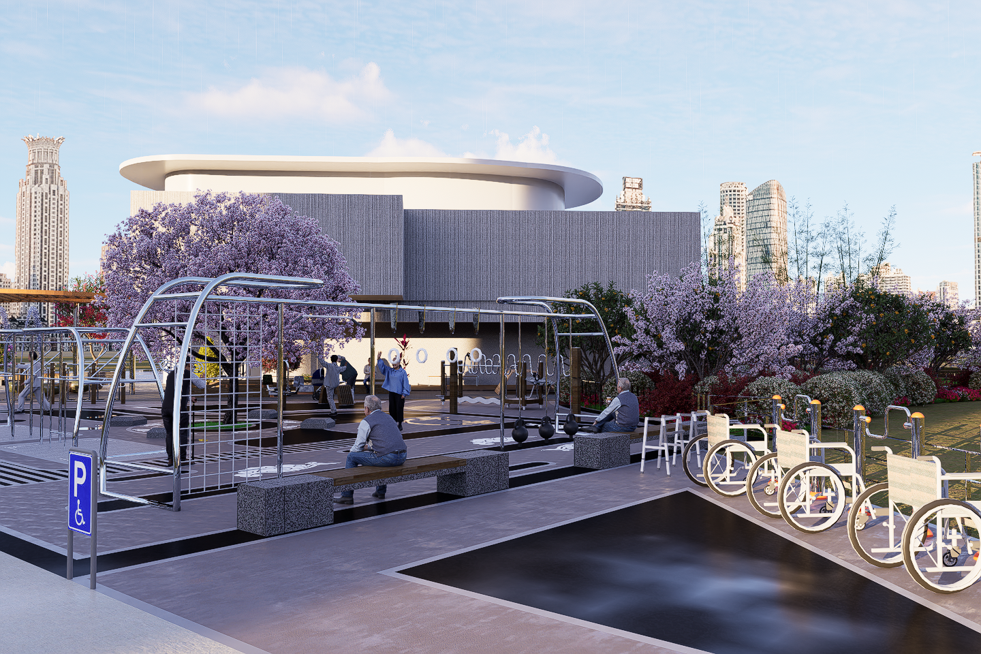
Region 2 Auxiliary equipment parking area

Slide 30
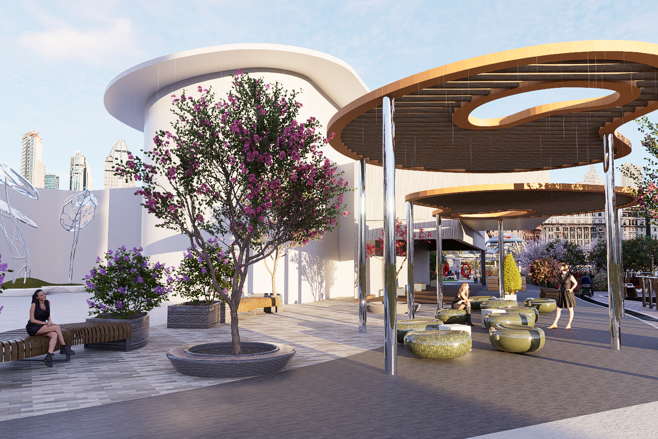
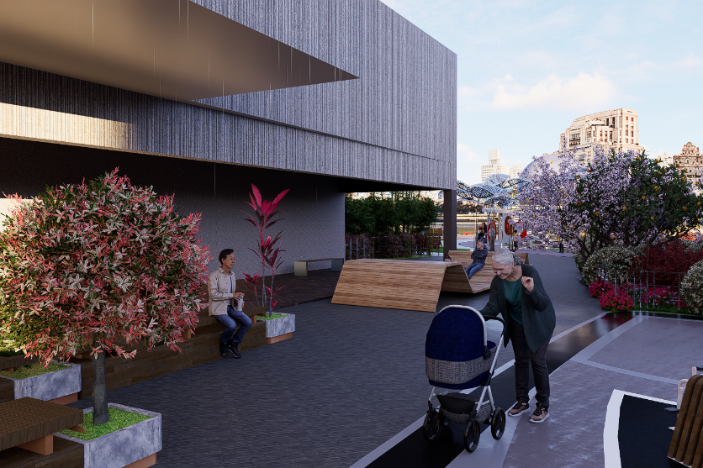
Region 3 Leisure Plaza

Slide 31
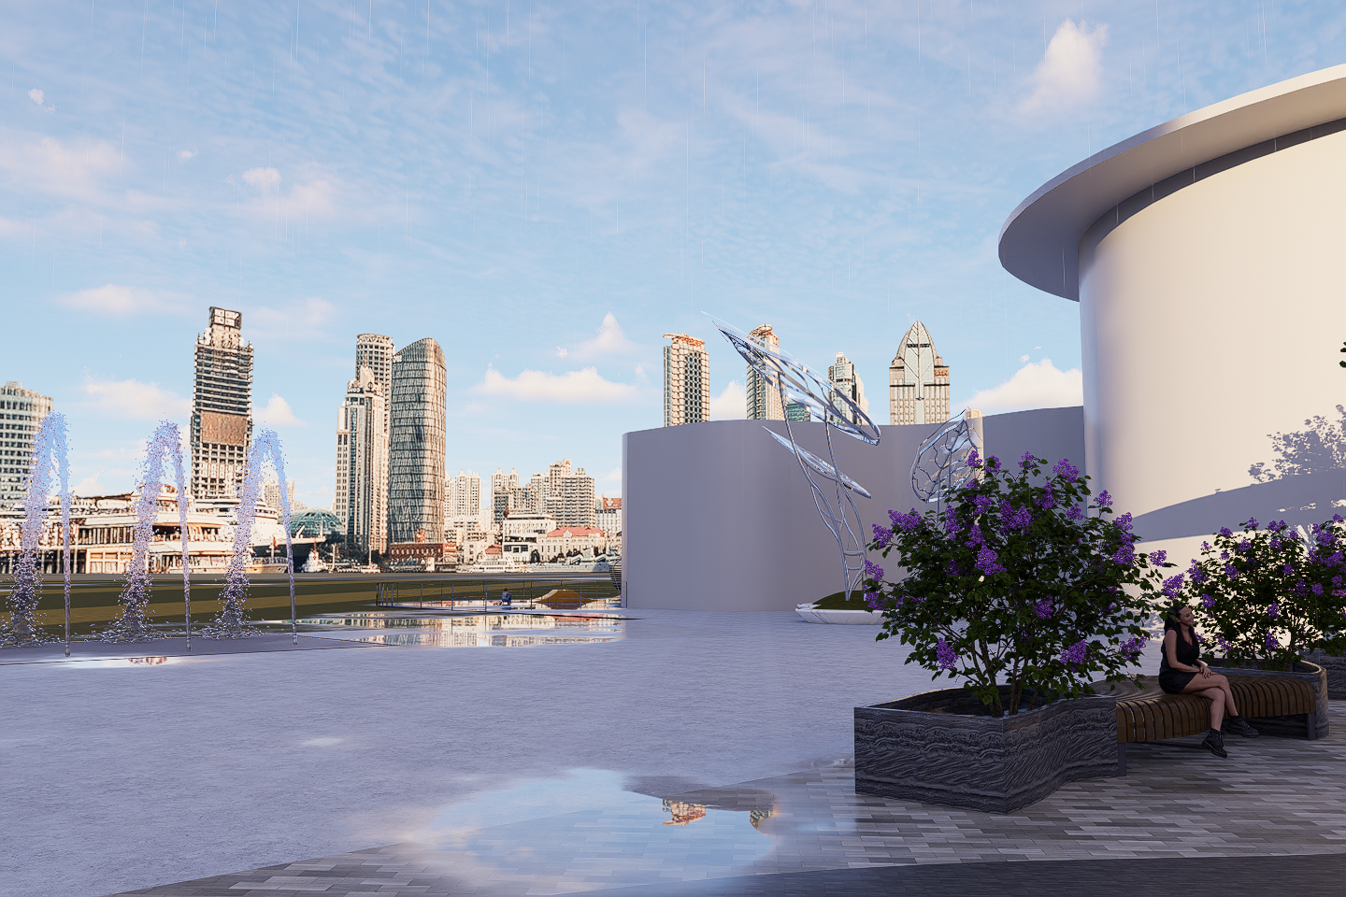
Region 4 Event square

Slide 32
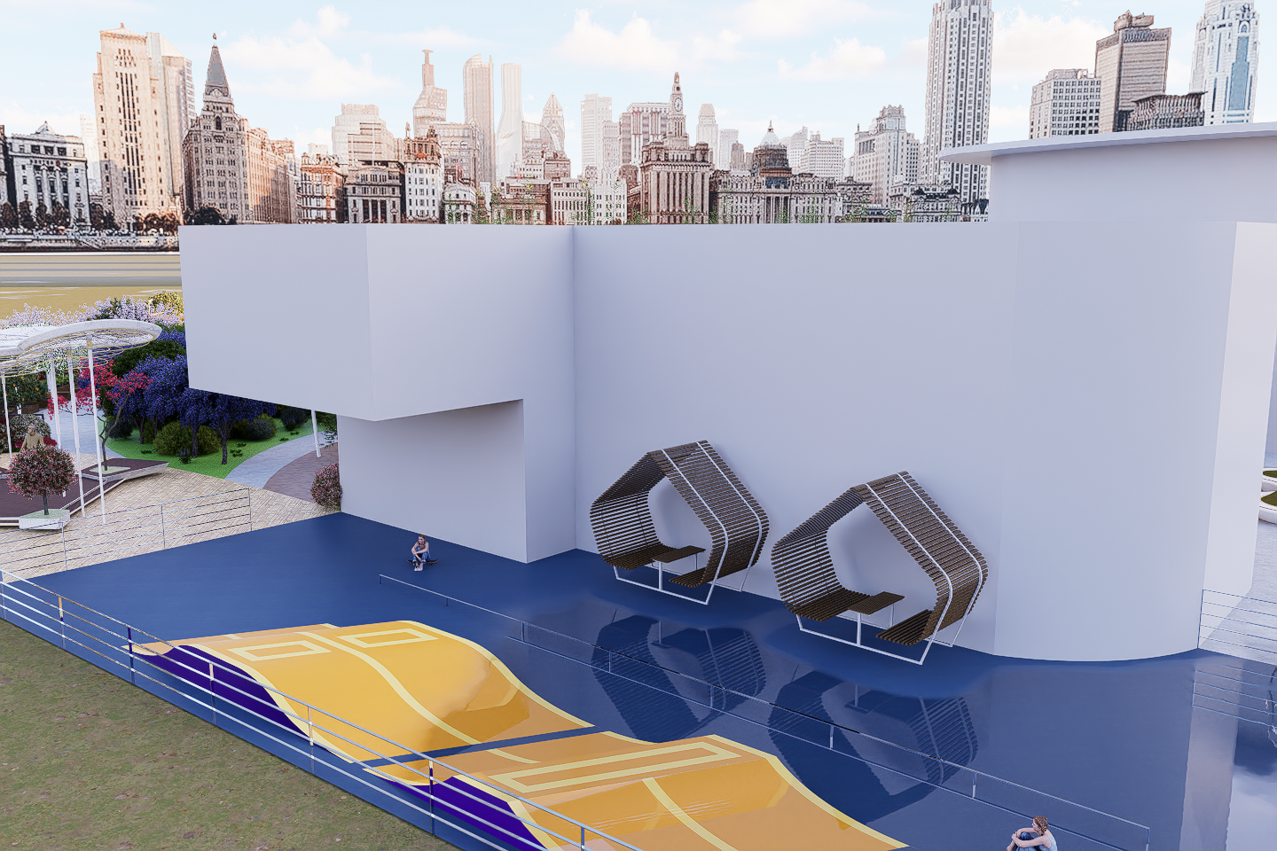
Region 5 Sports Square

Slide 33
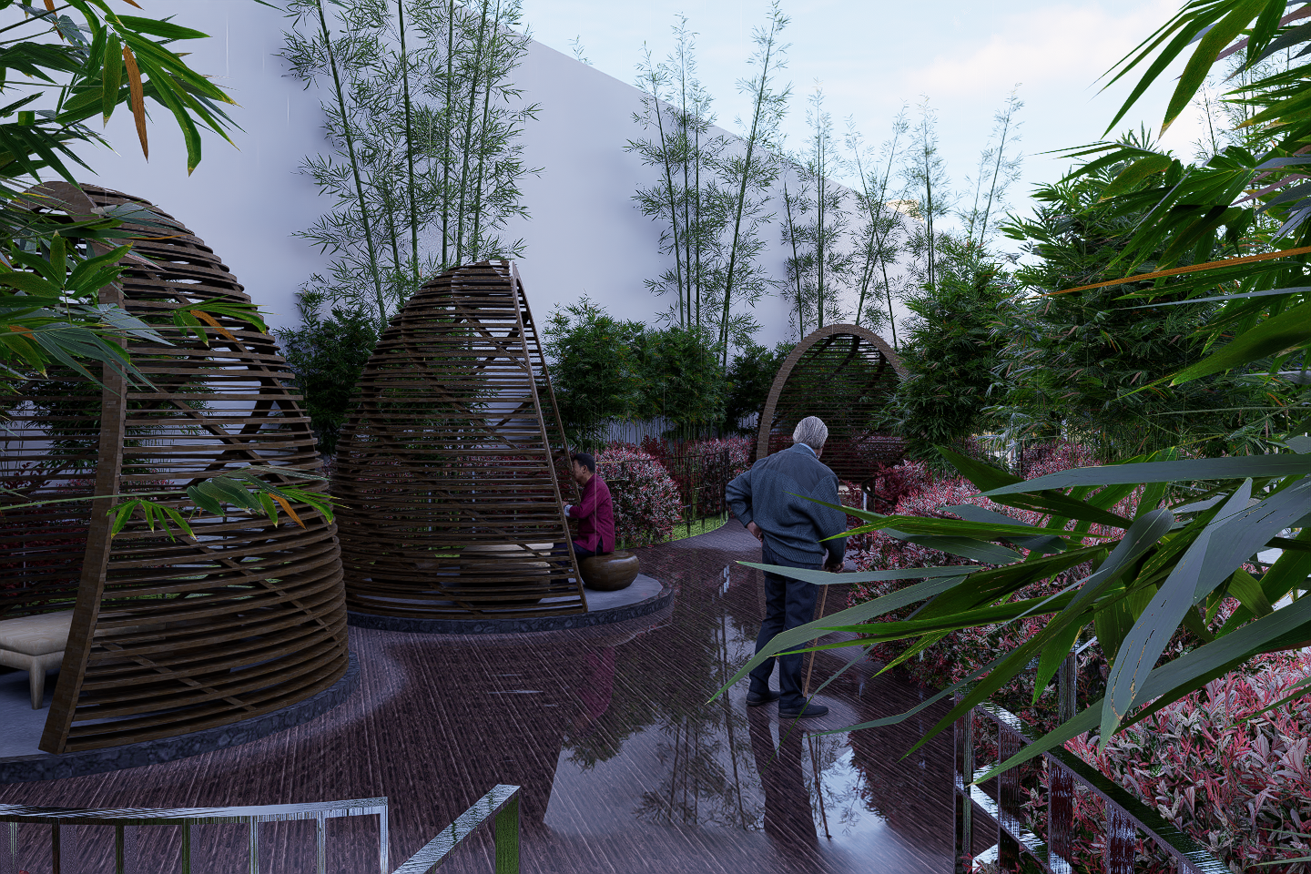
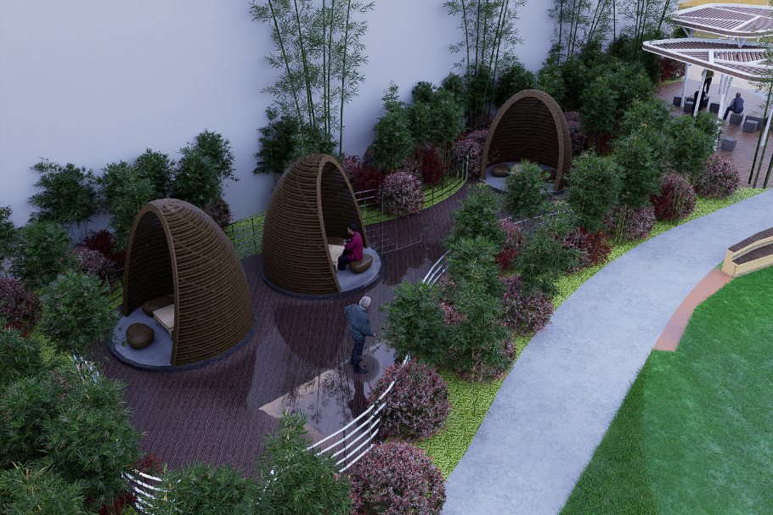
Region 7 Quiet relaxation area

Slide 34
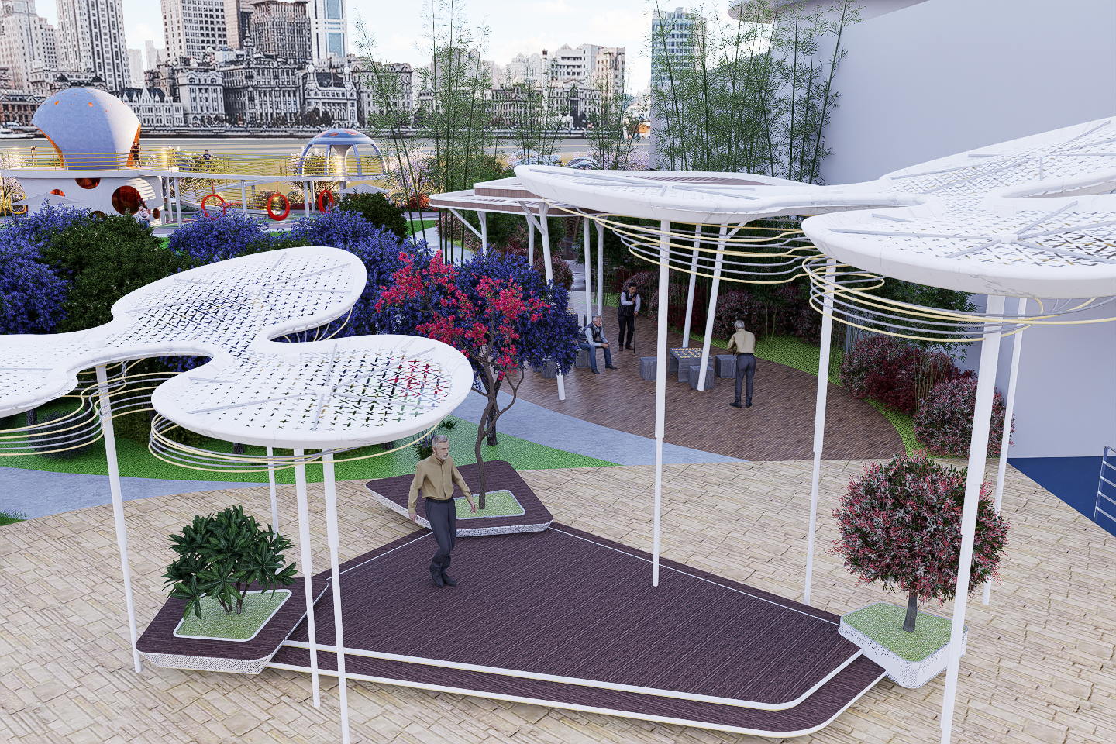
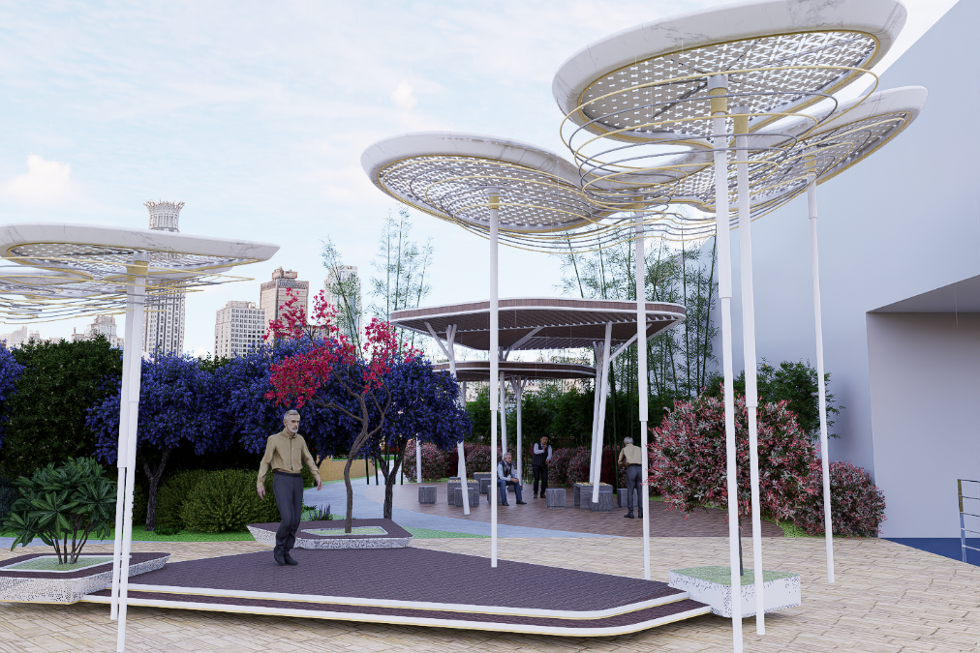
Region 8 General leisure area

Slide 35


Region 10 Children's leisure activity square

Slide 36


Region 11 Sunshine lawn

Slide 37


Region 12 Small basketball court

Slide 38


Region 13 Community shared garden

Slide 39
Thanks for watching
Thank you for listening
Reporter: Reeves (Yizeng Kong）
Notes:
<номер>

